Slide 1
Radio Telescope Project of the Des Moines Astronomical Society (August, 2019) Power Point by Vern Naffier Photography by Joyce Naffier

Slide 2
I. The Big Dish

Slide 3
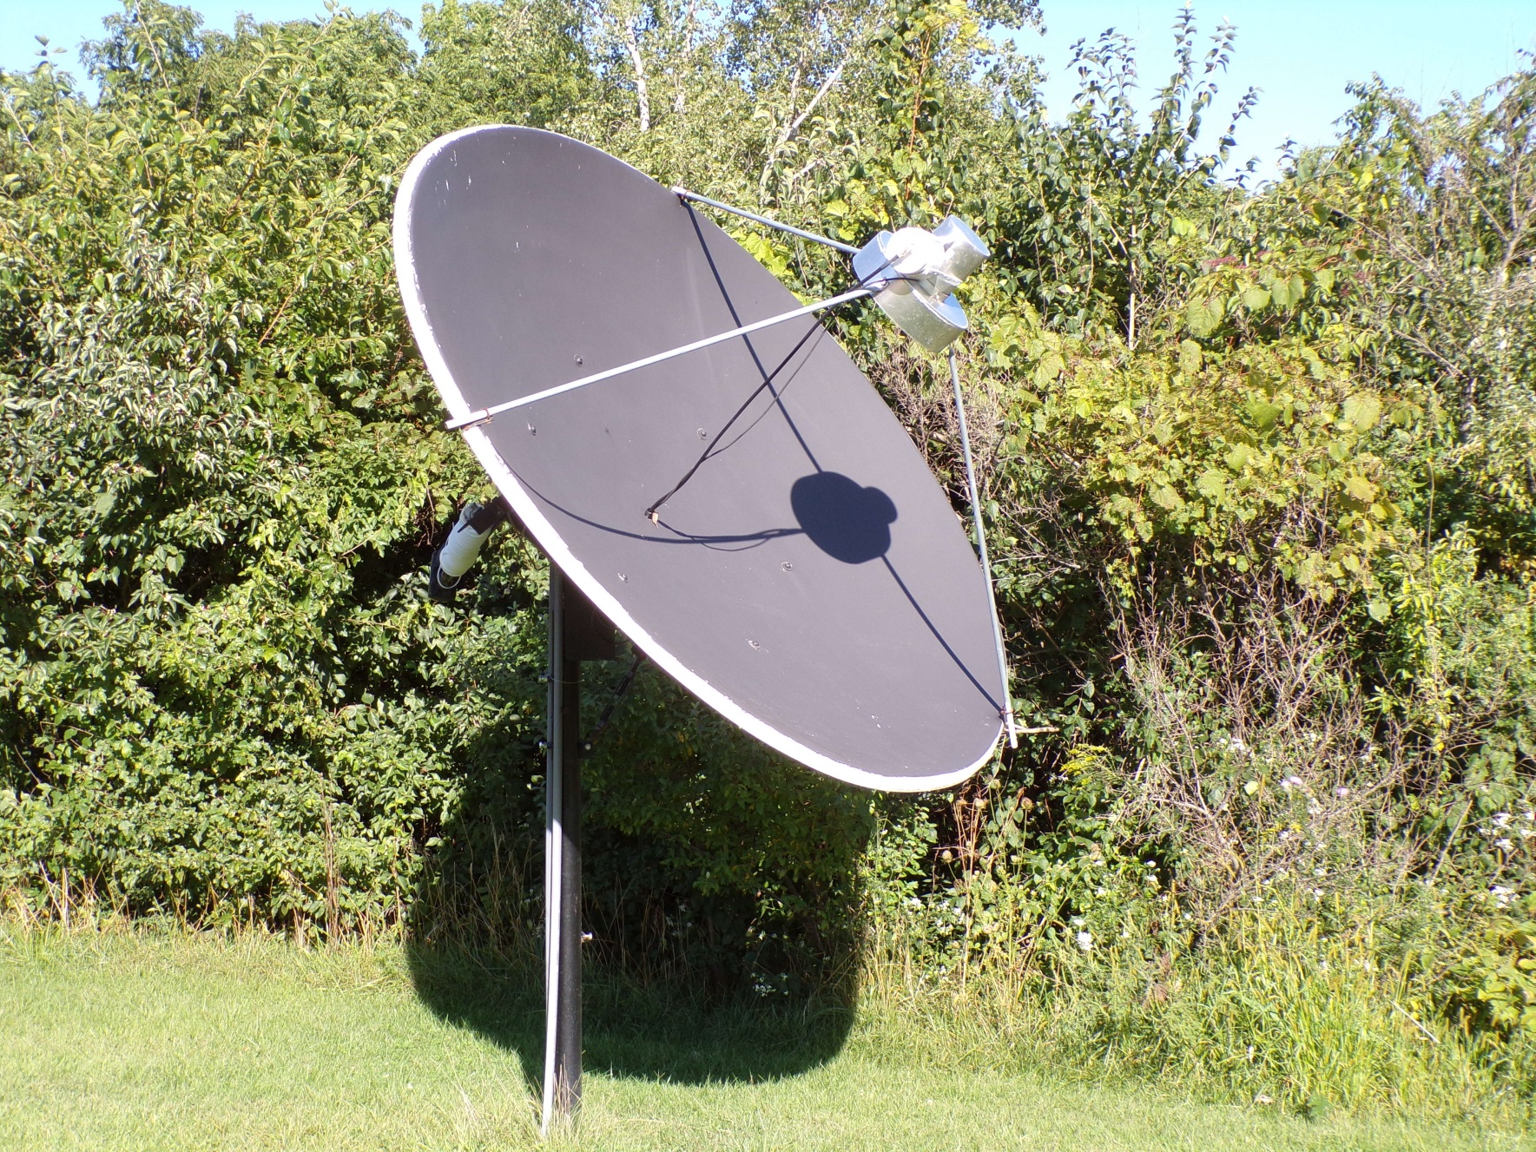

Slide 4
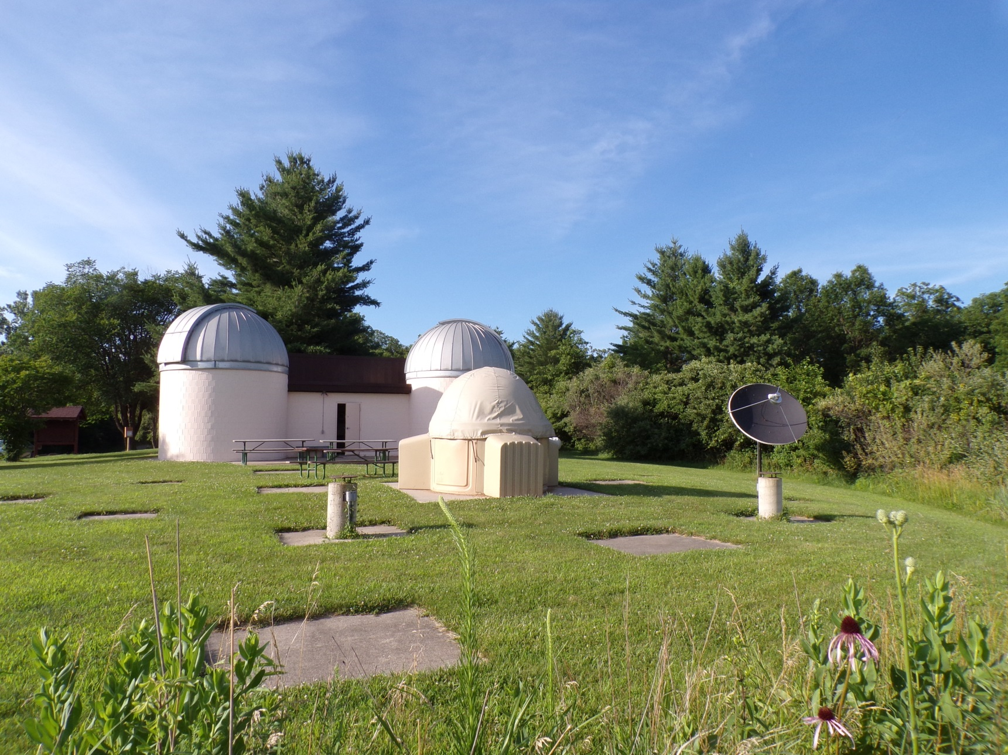

Slide 5
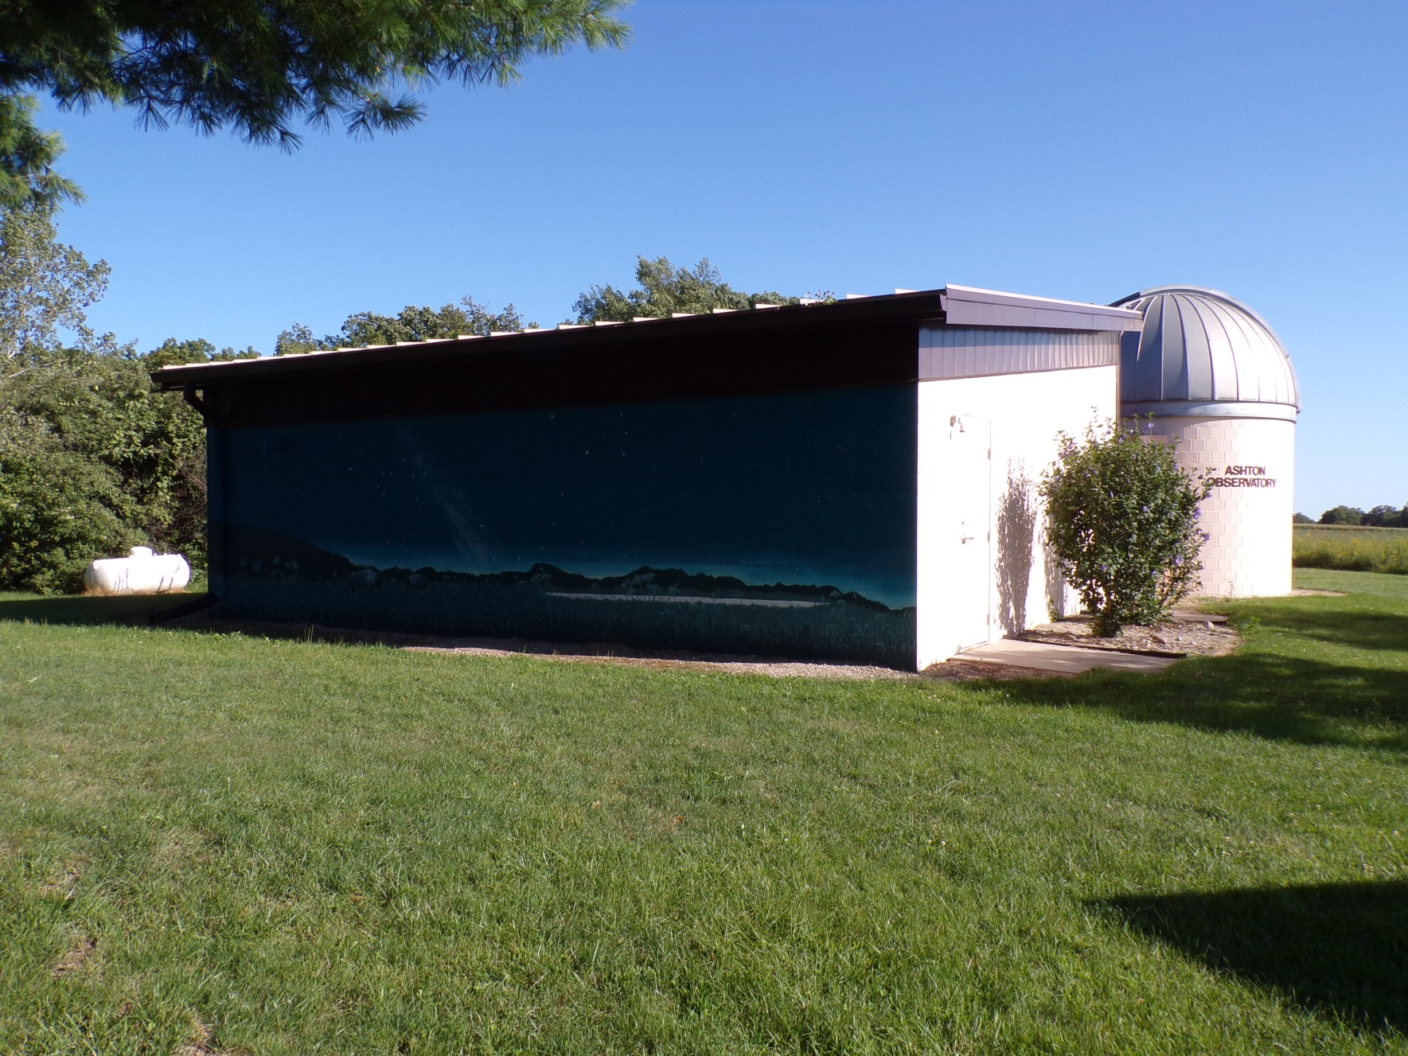

Slide 6
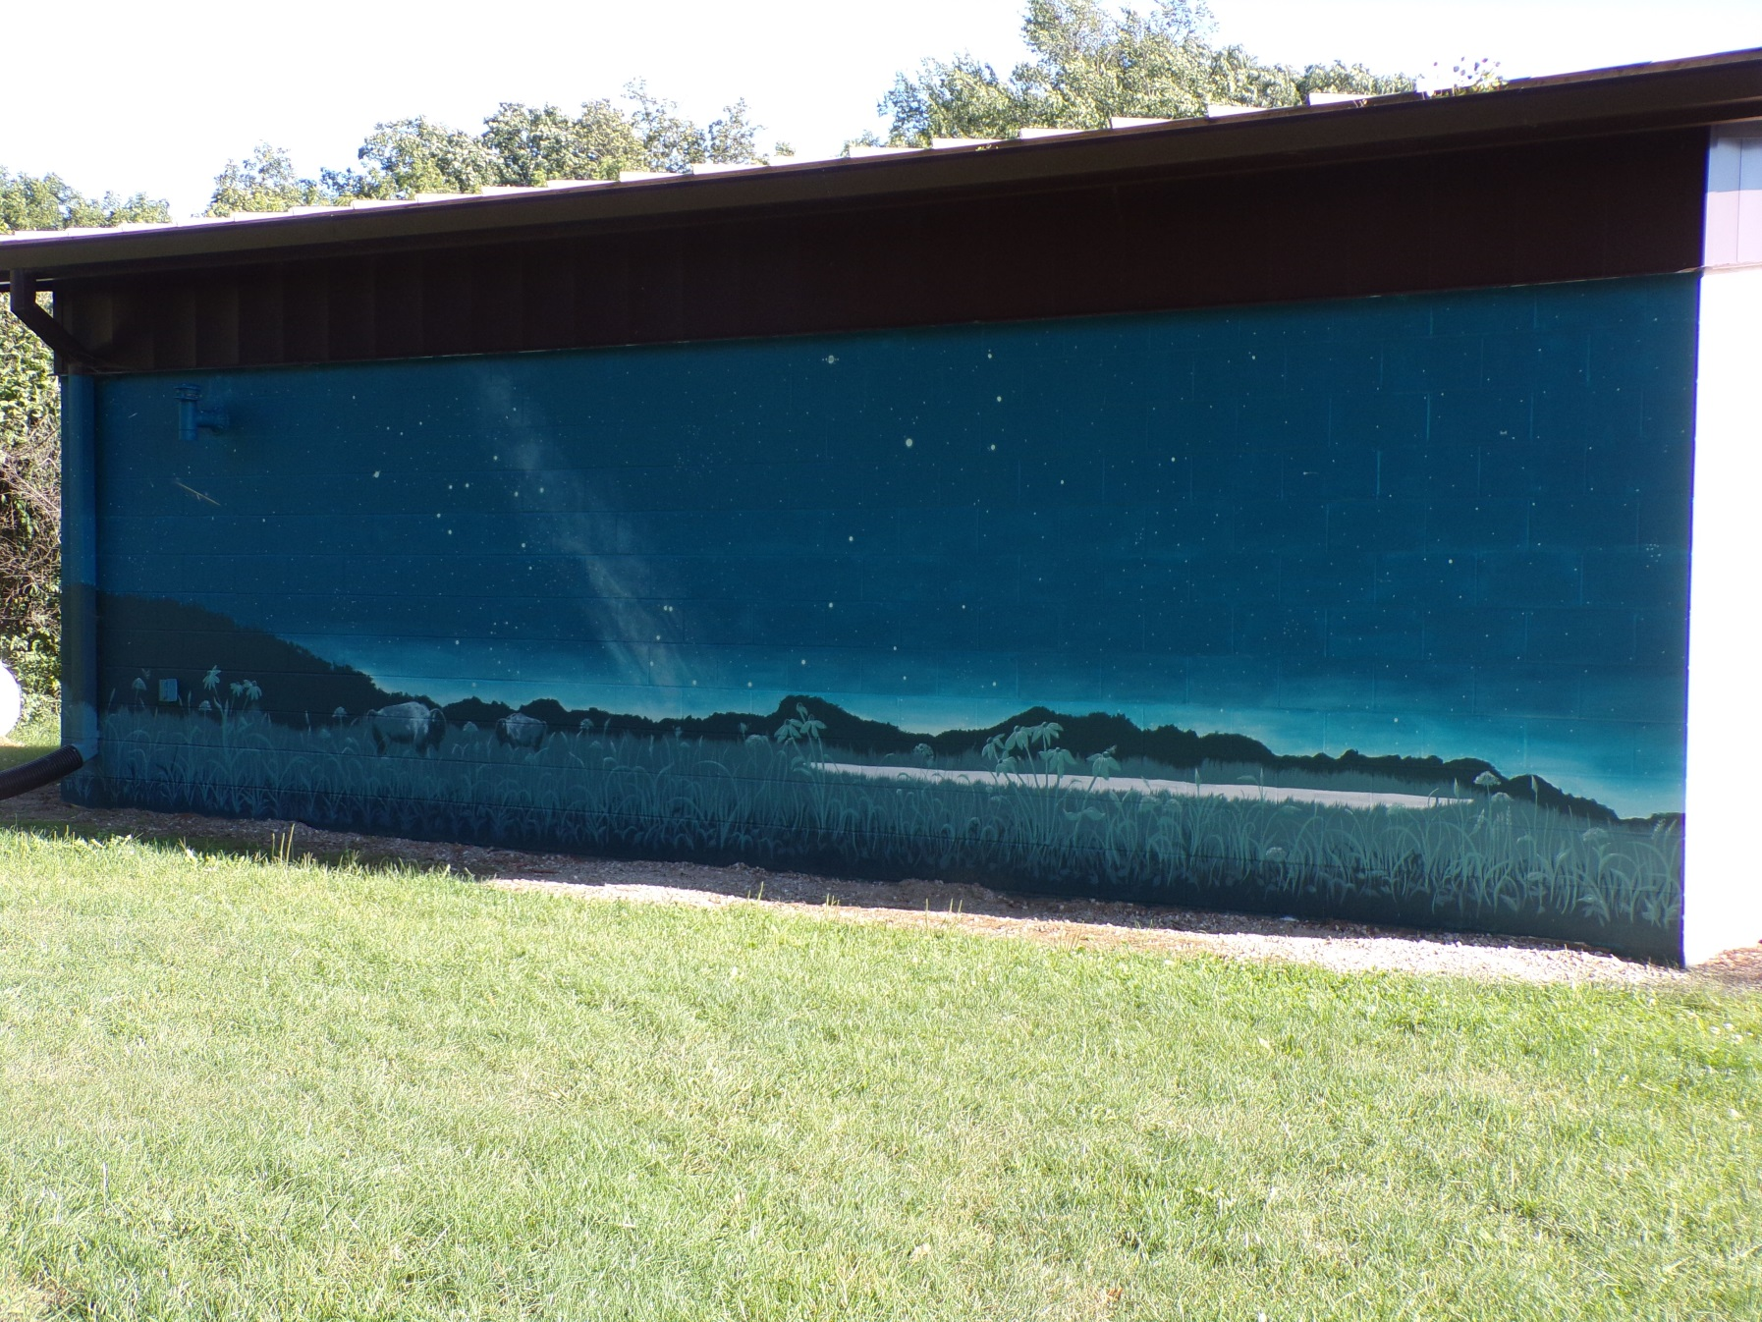

Slide 7
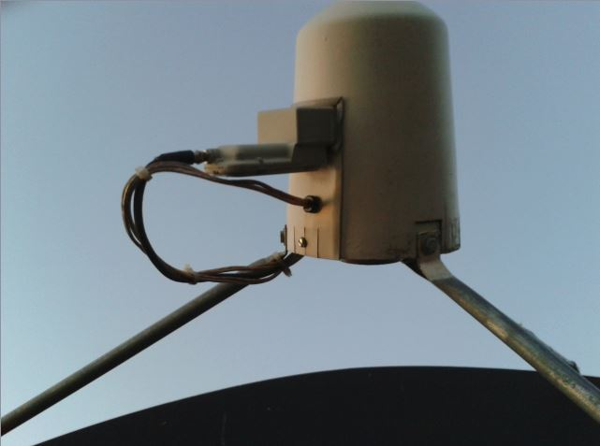
Old 12 GHz Feed Horn

Slide 8
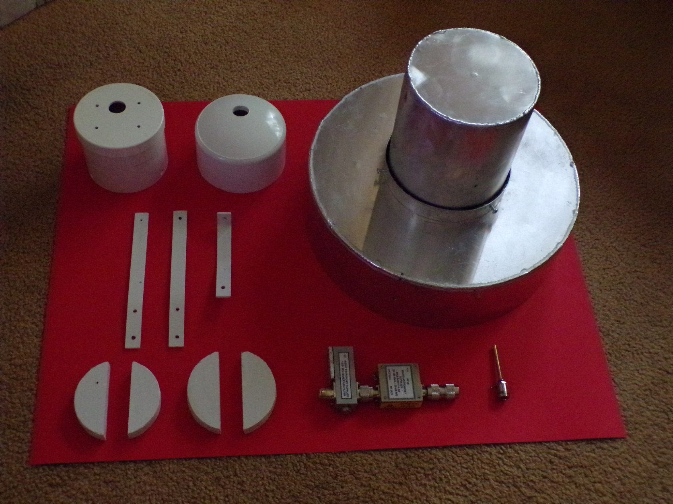
Components of the 1.42 GHz Feed Horn

Slide 9
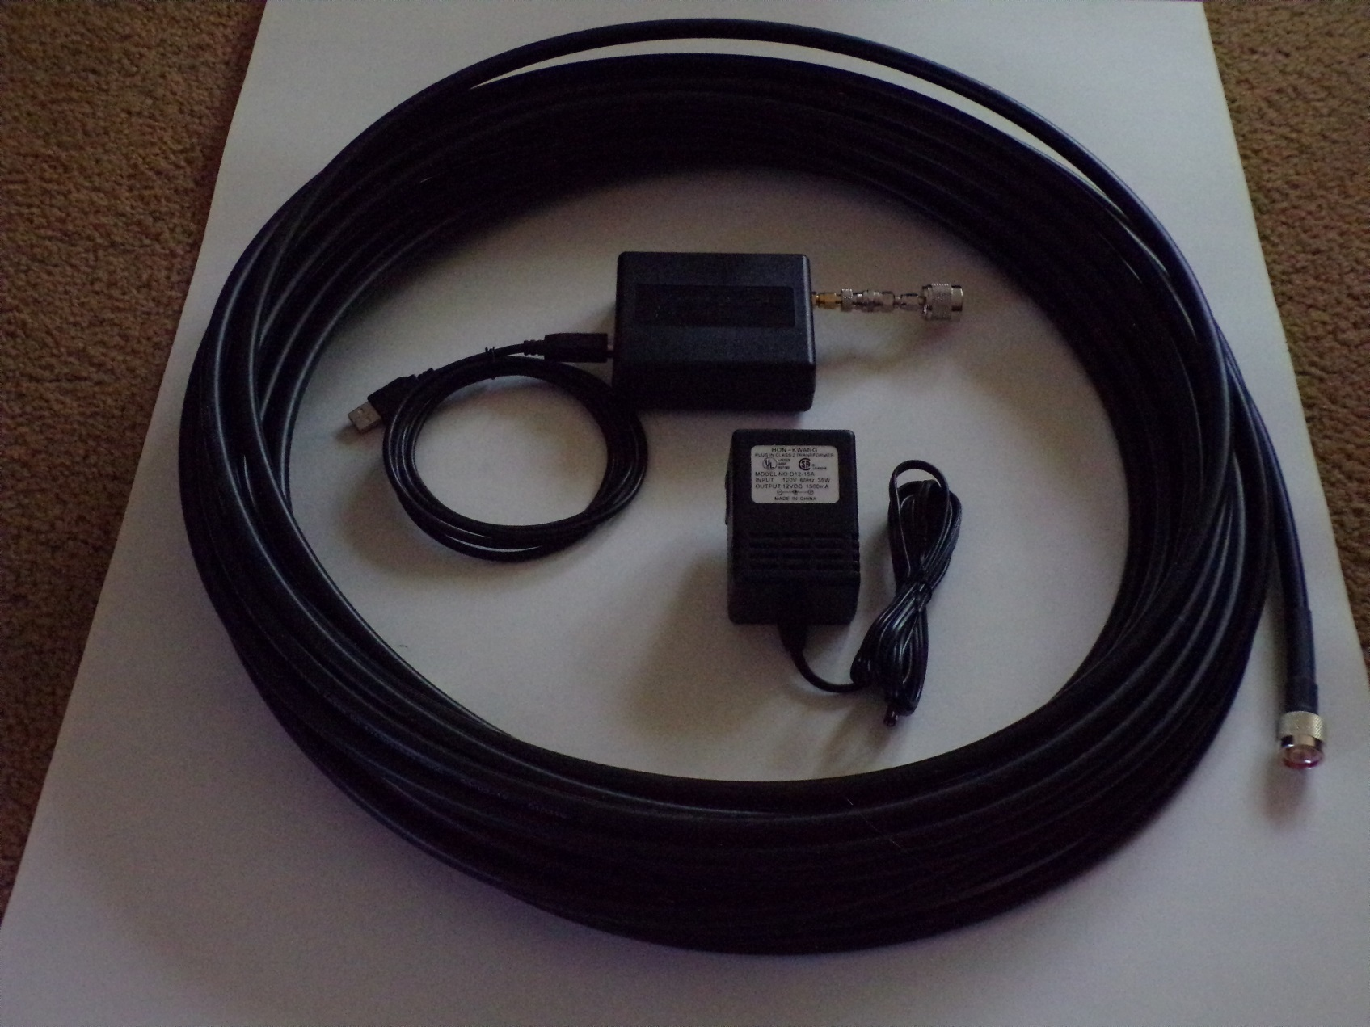
SDR, Power Supply and coax power cable to the Feed Horn

Slide 10
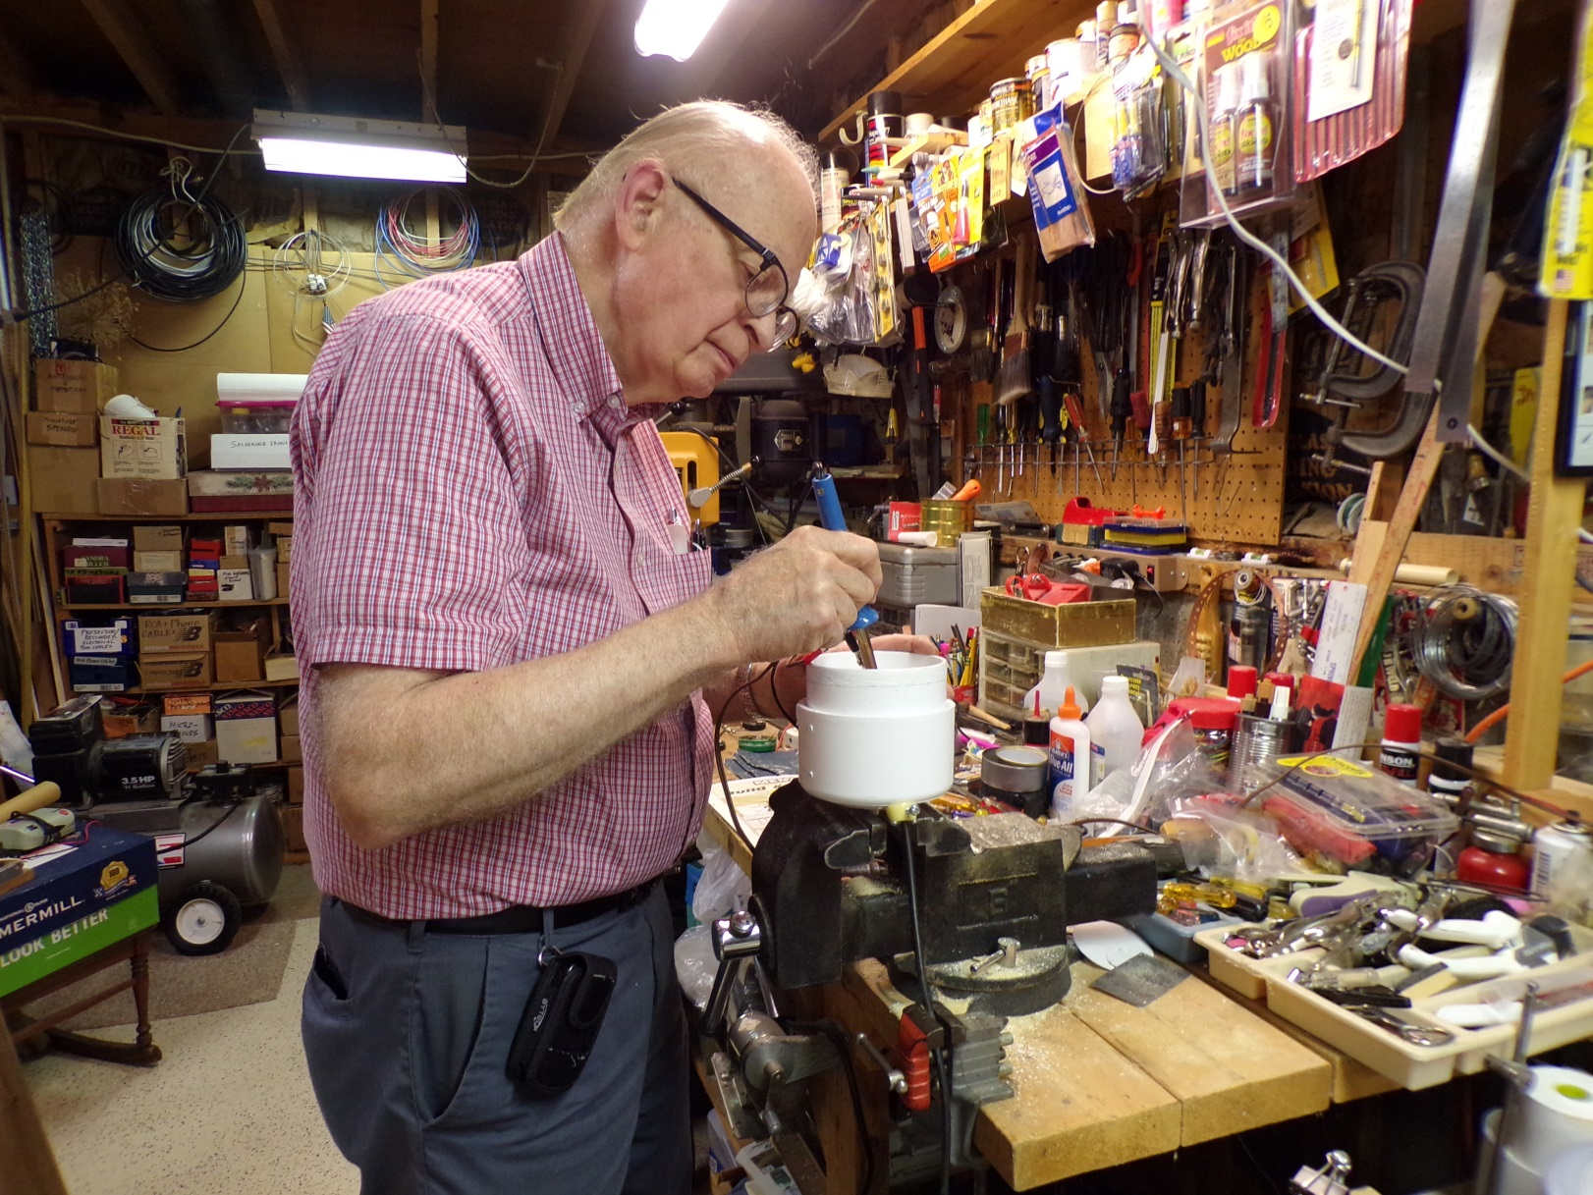
Vern Building the Component Housing

Slide 11
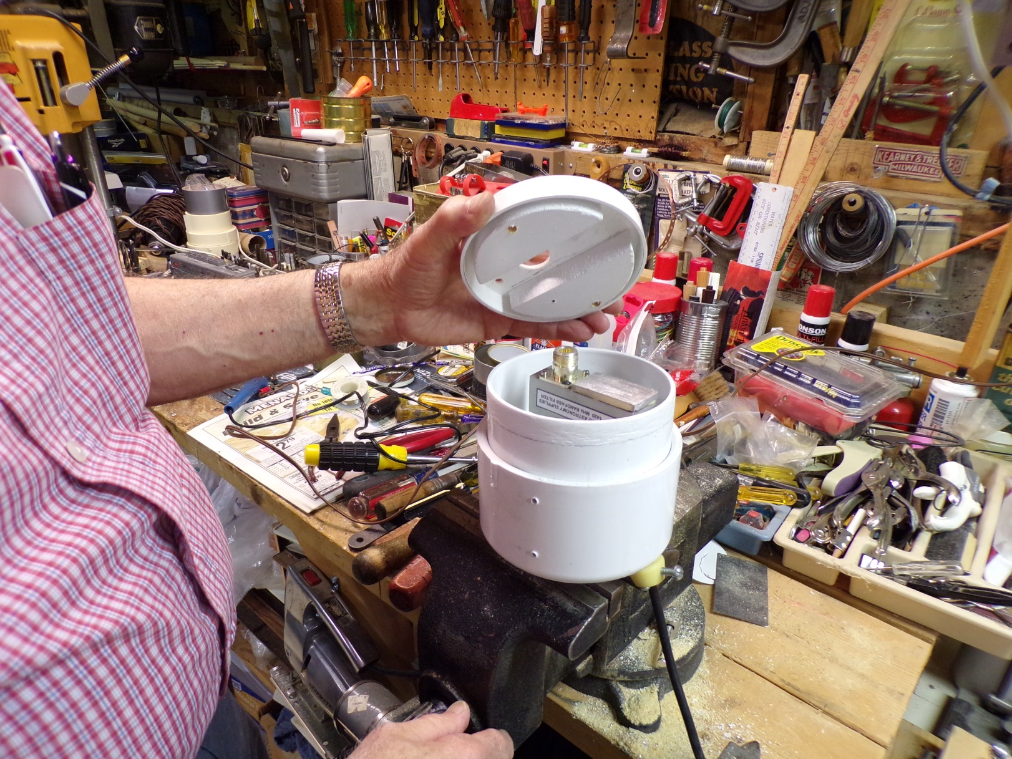
Now insert the components

Slide 12
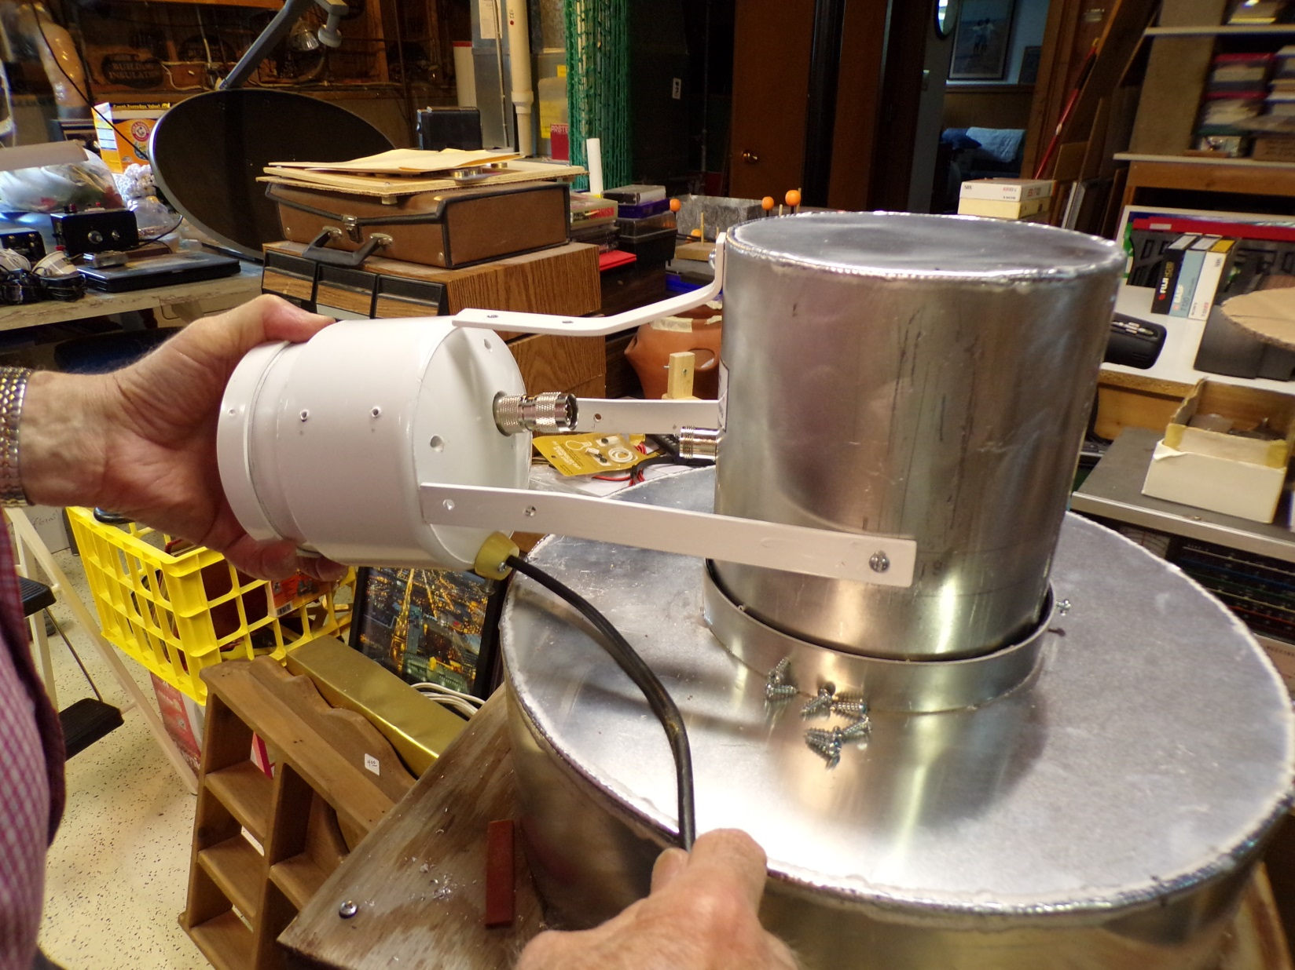
And attach component housing to the feed horn

Slide 13
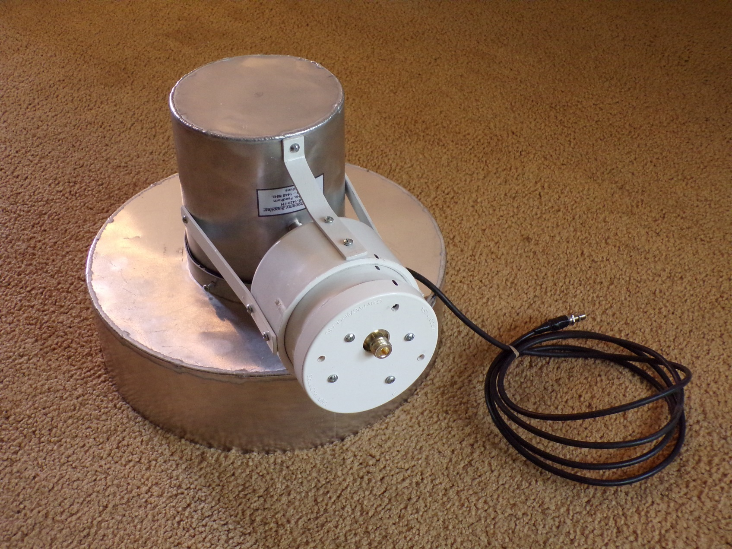
The Finished Product - New 1.42 GHz Feed Horn

Slide 14
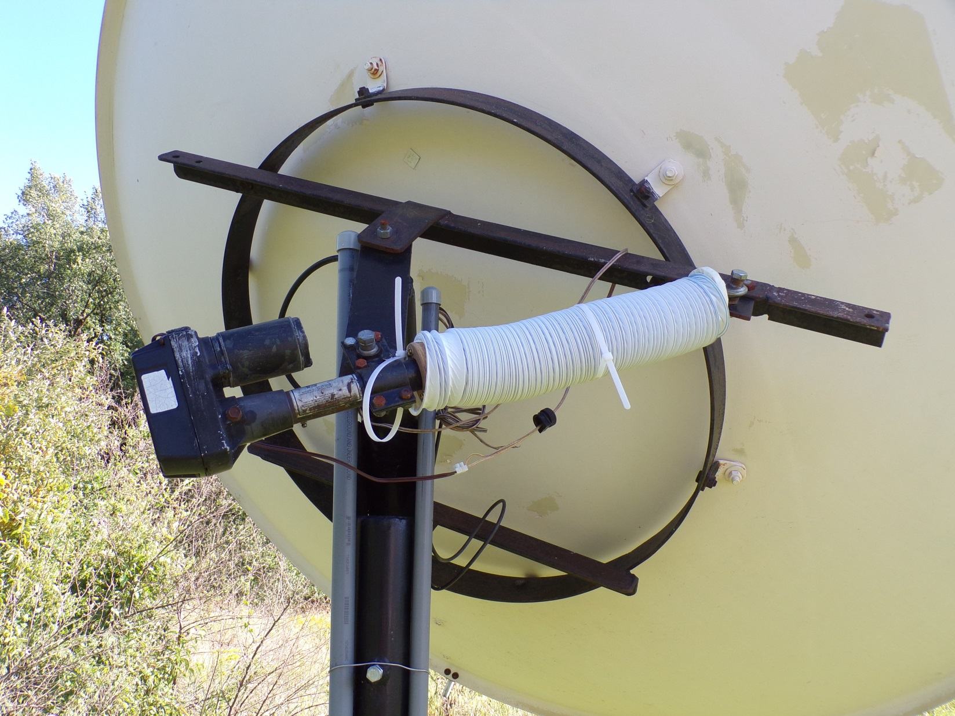
Azimuth Axis and Motor on the Dish Antenna

Slide 15
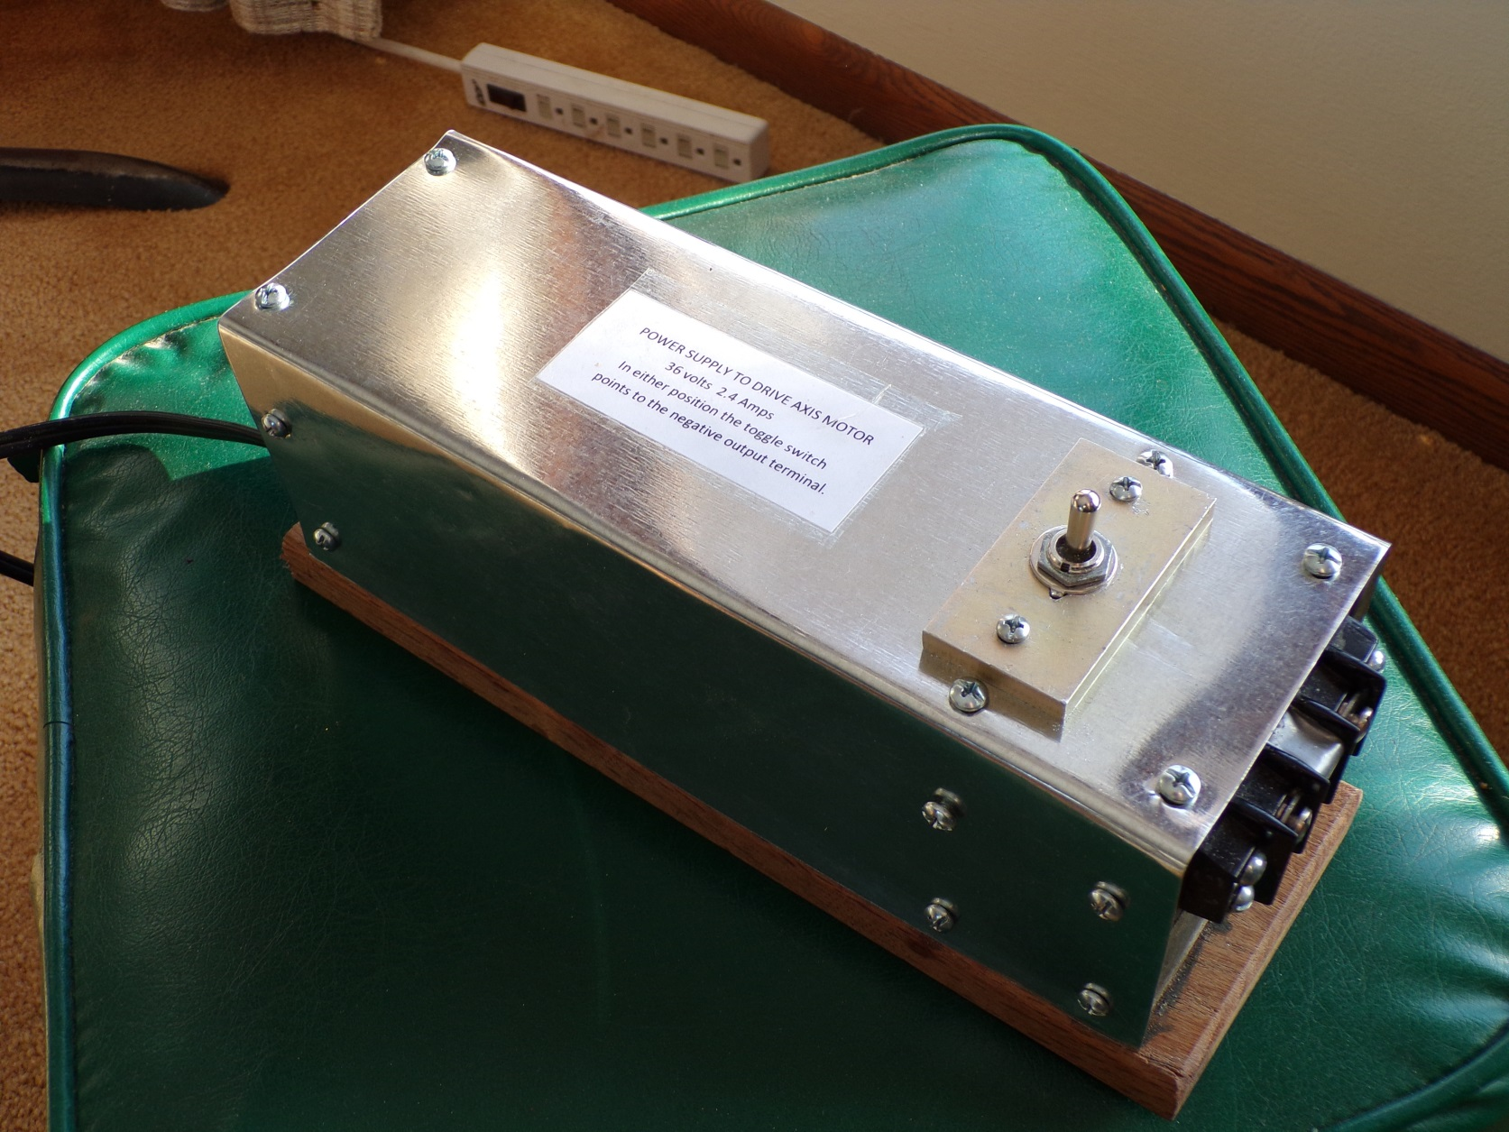
Axis Motor Power Supply

Slide 16
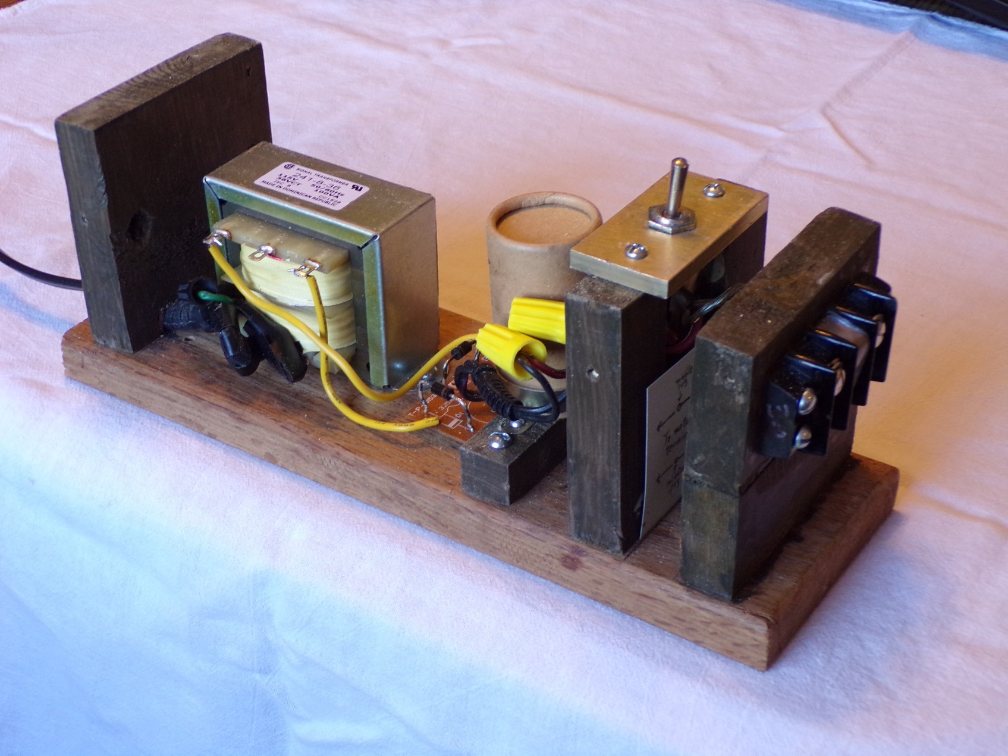
Looking inside the Power Supply

Slide 17
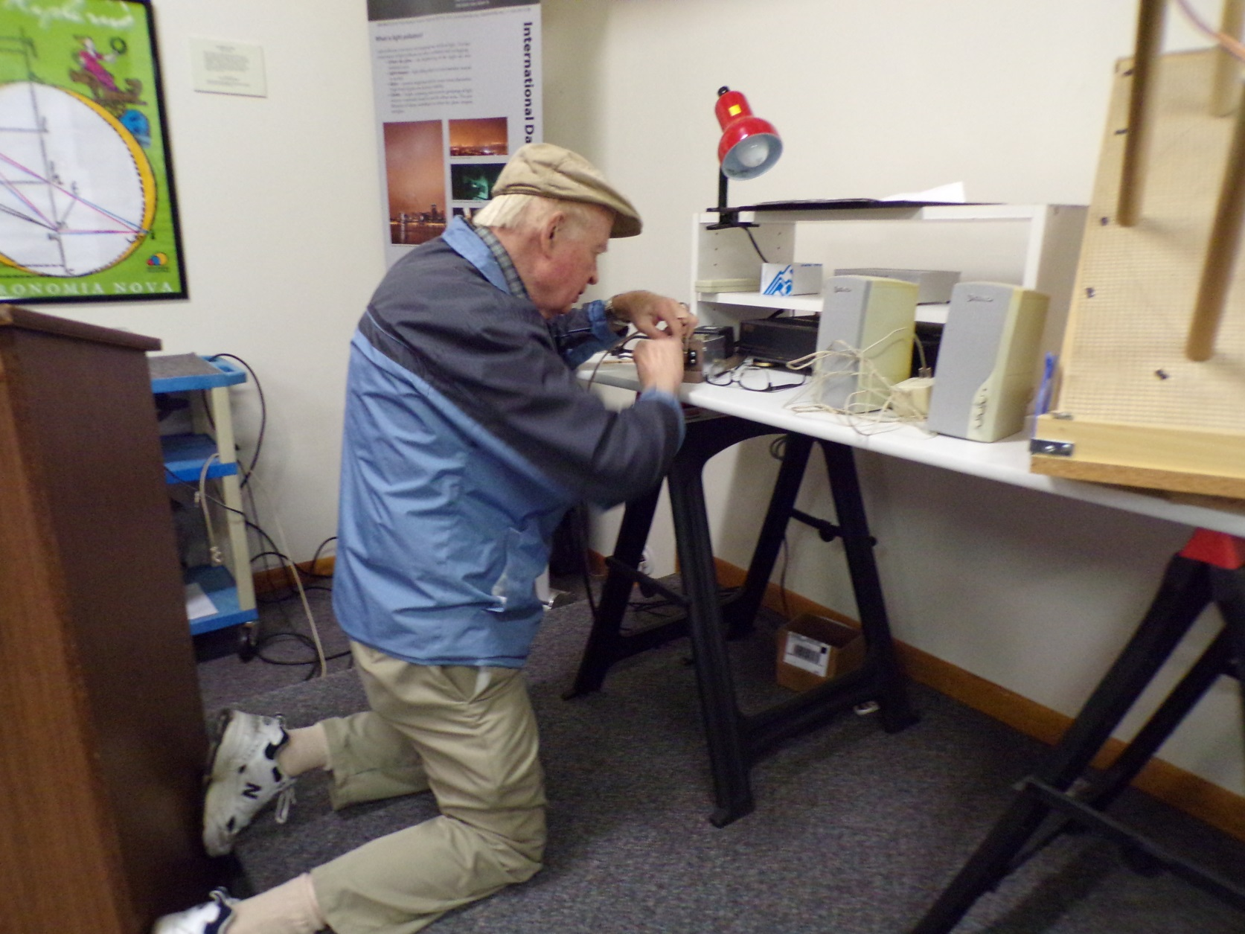
Vern connecting up the Power Supply

Slide 18
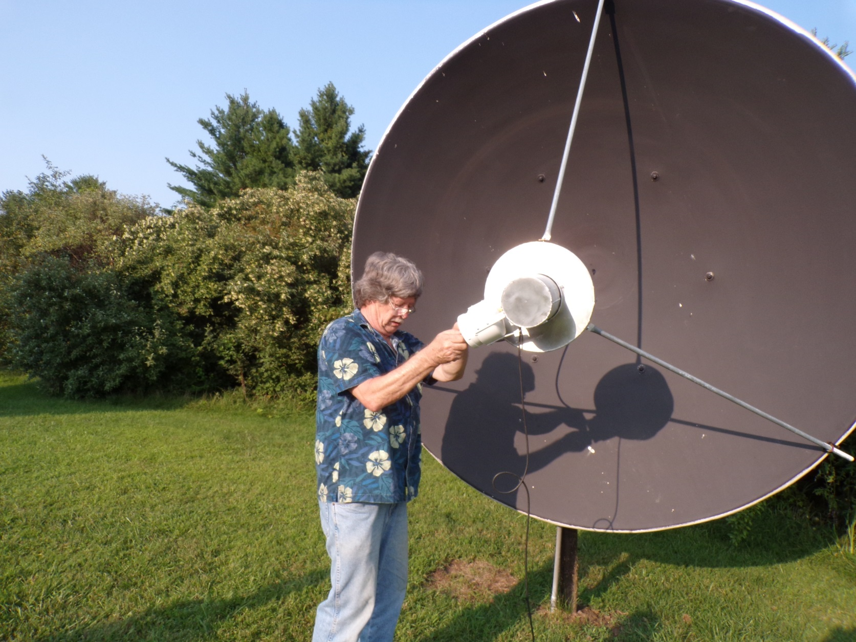
Larry making power connections at the axis

Slide 19
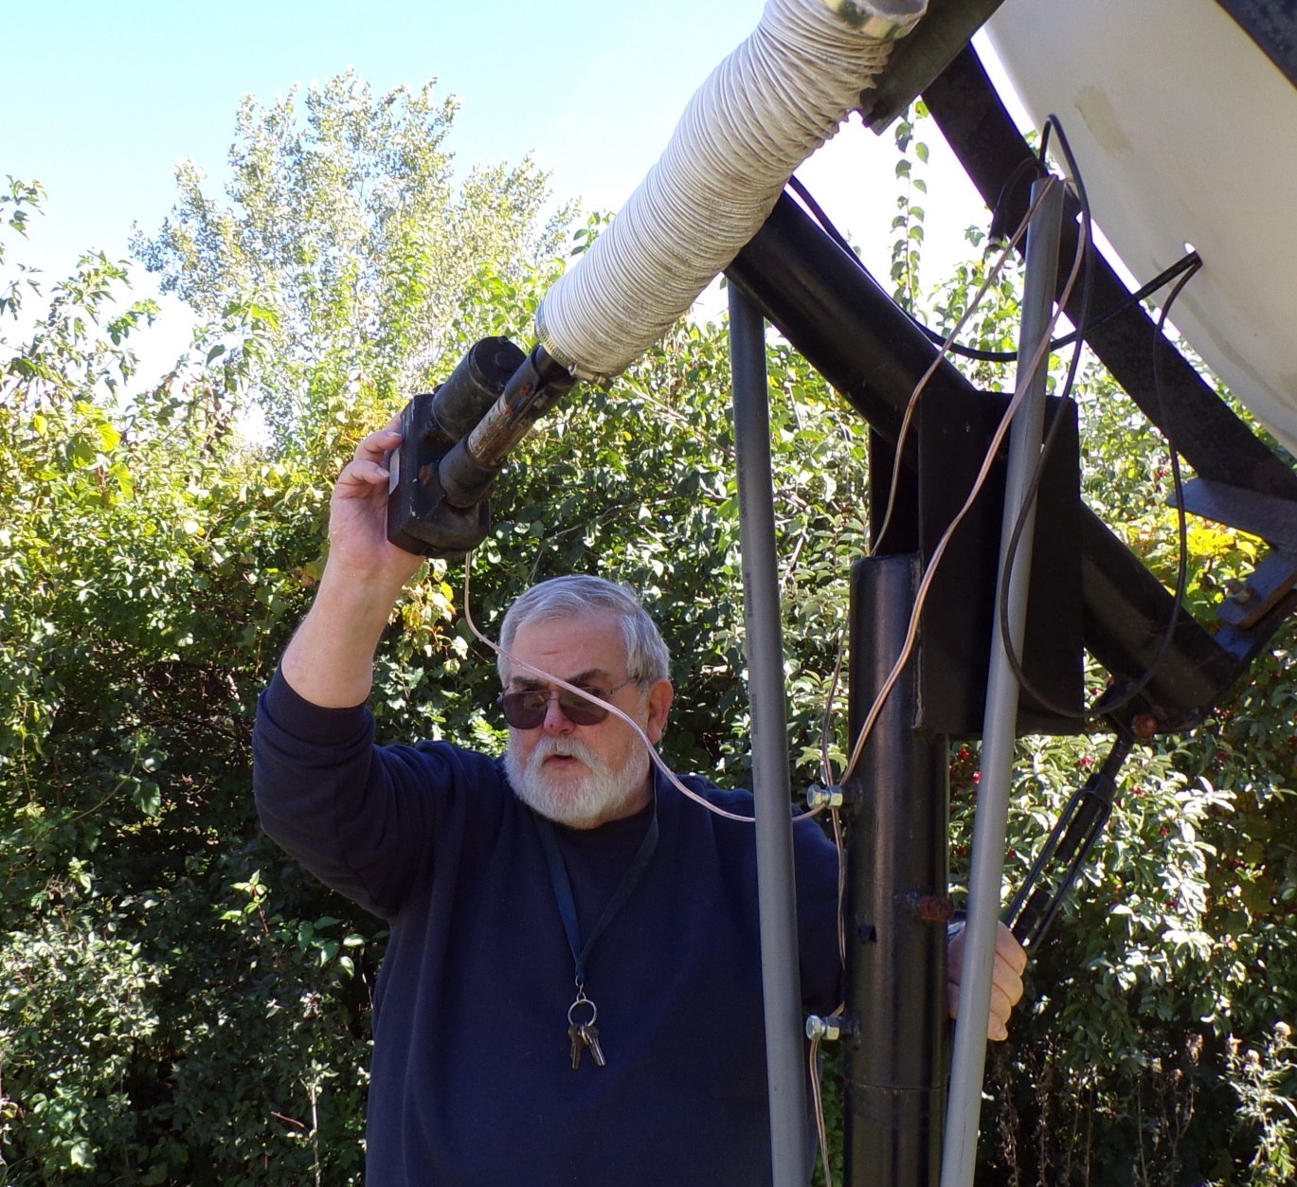
Dave working on the axis assembly

Slide 20
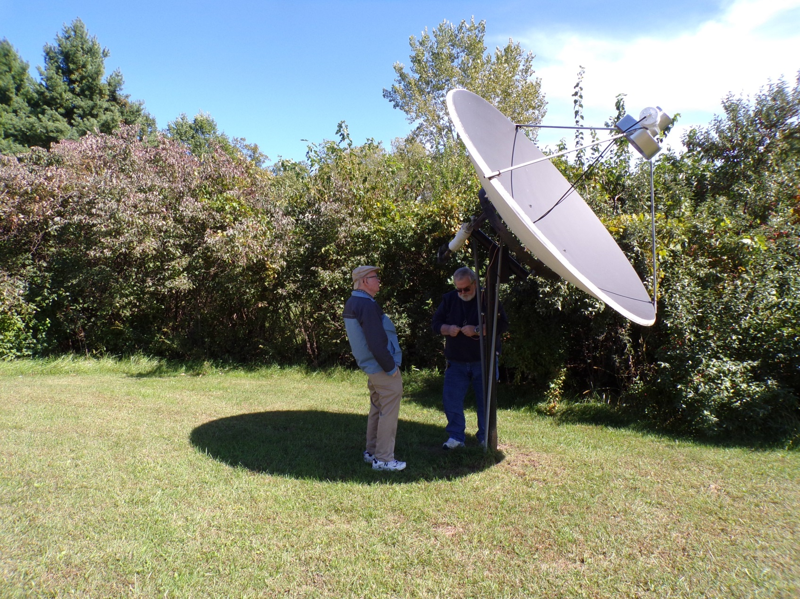
Dave and Vern working at the dish

Slide 21
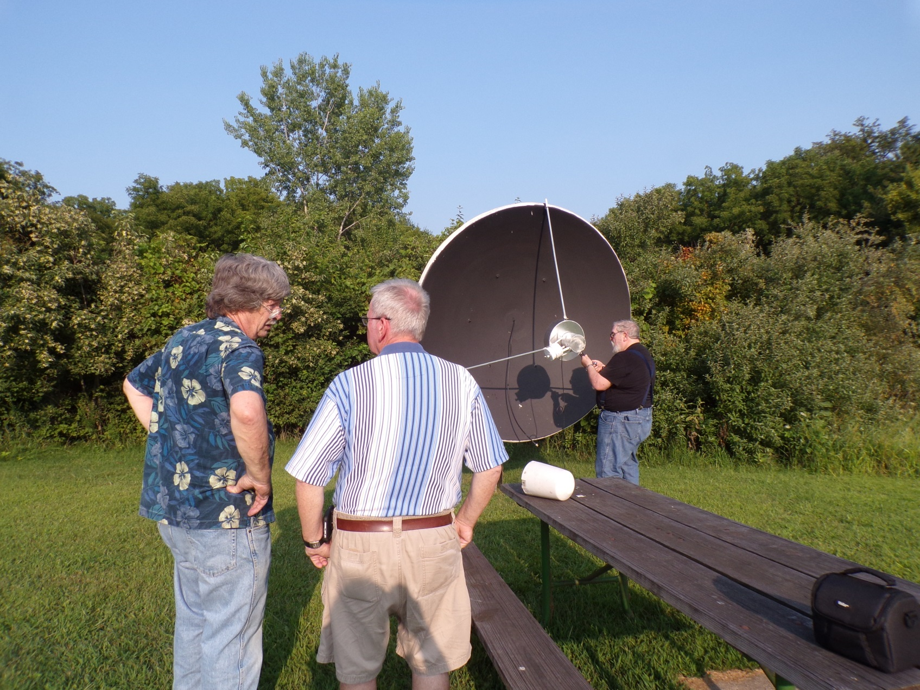
Larry, Herb, and Dave putting it together

Slide 22
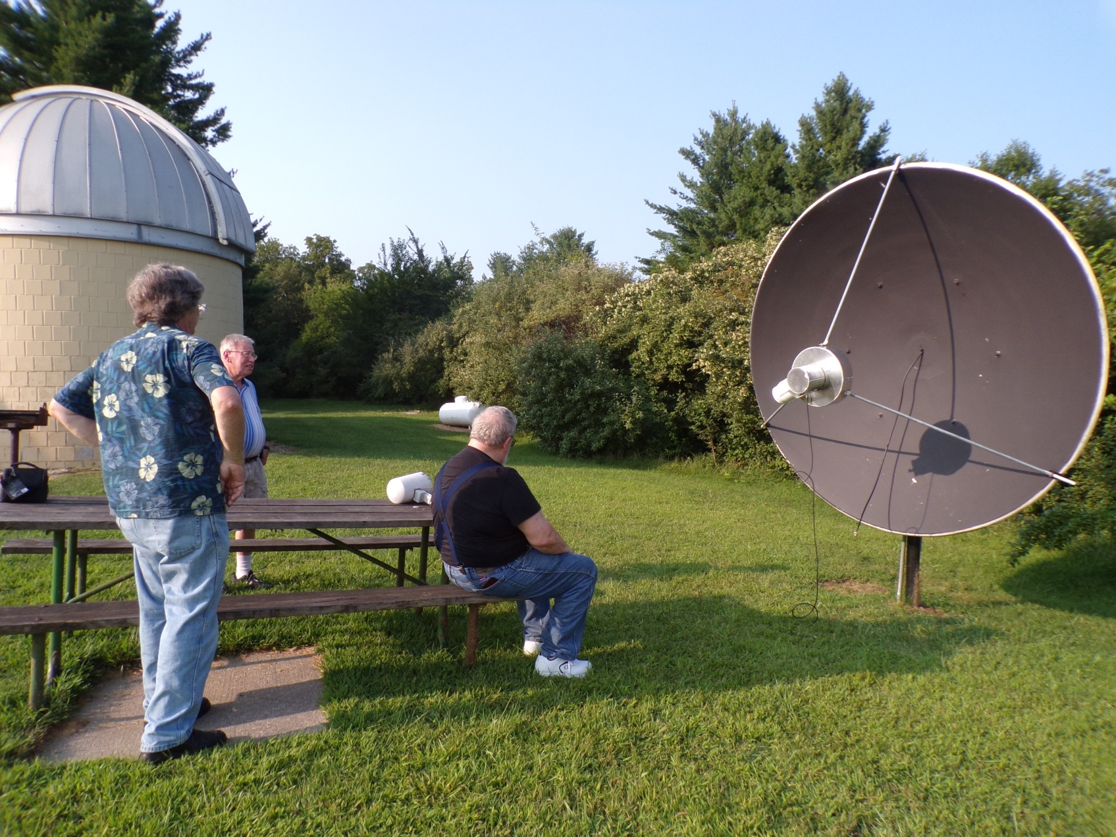
Looking it over

Slide 23
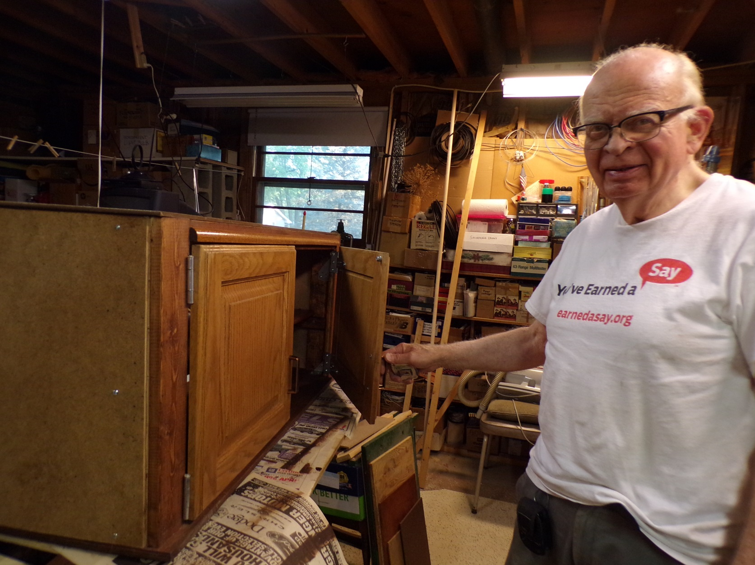
Vern building the radio telescope console cabinet

Slide 24
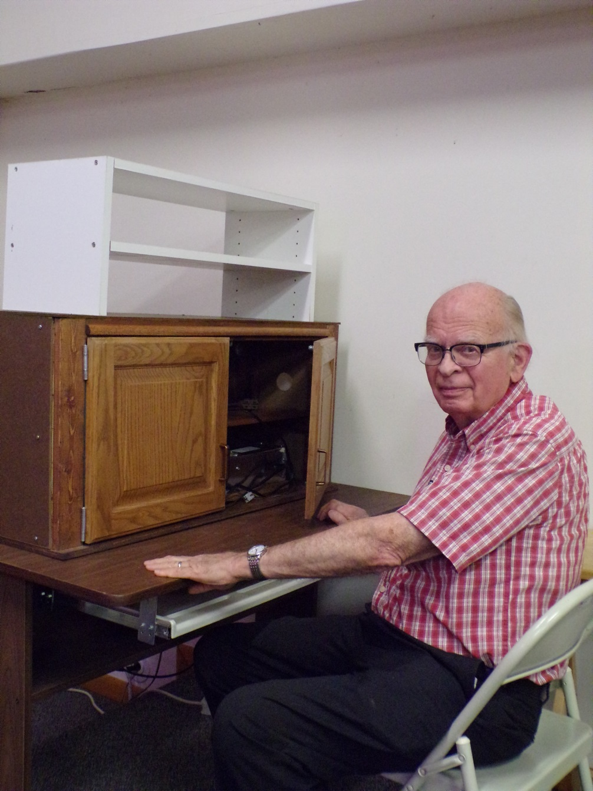
Vern at the Console

Slide 25
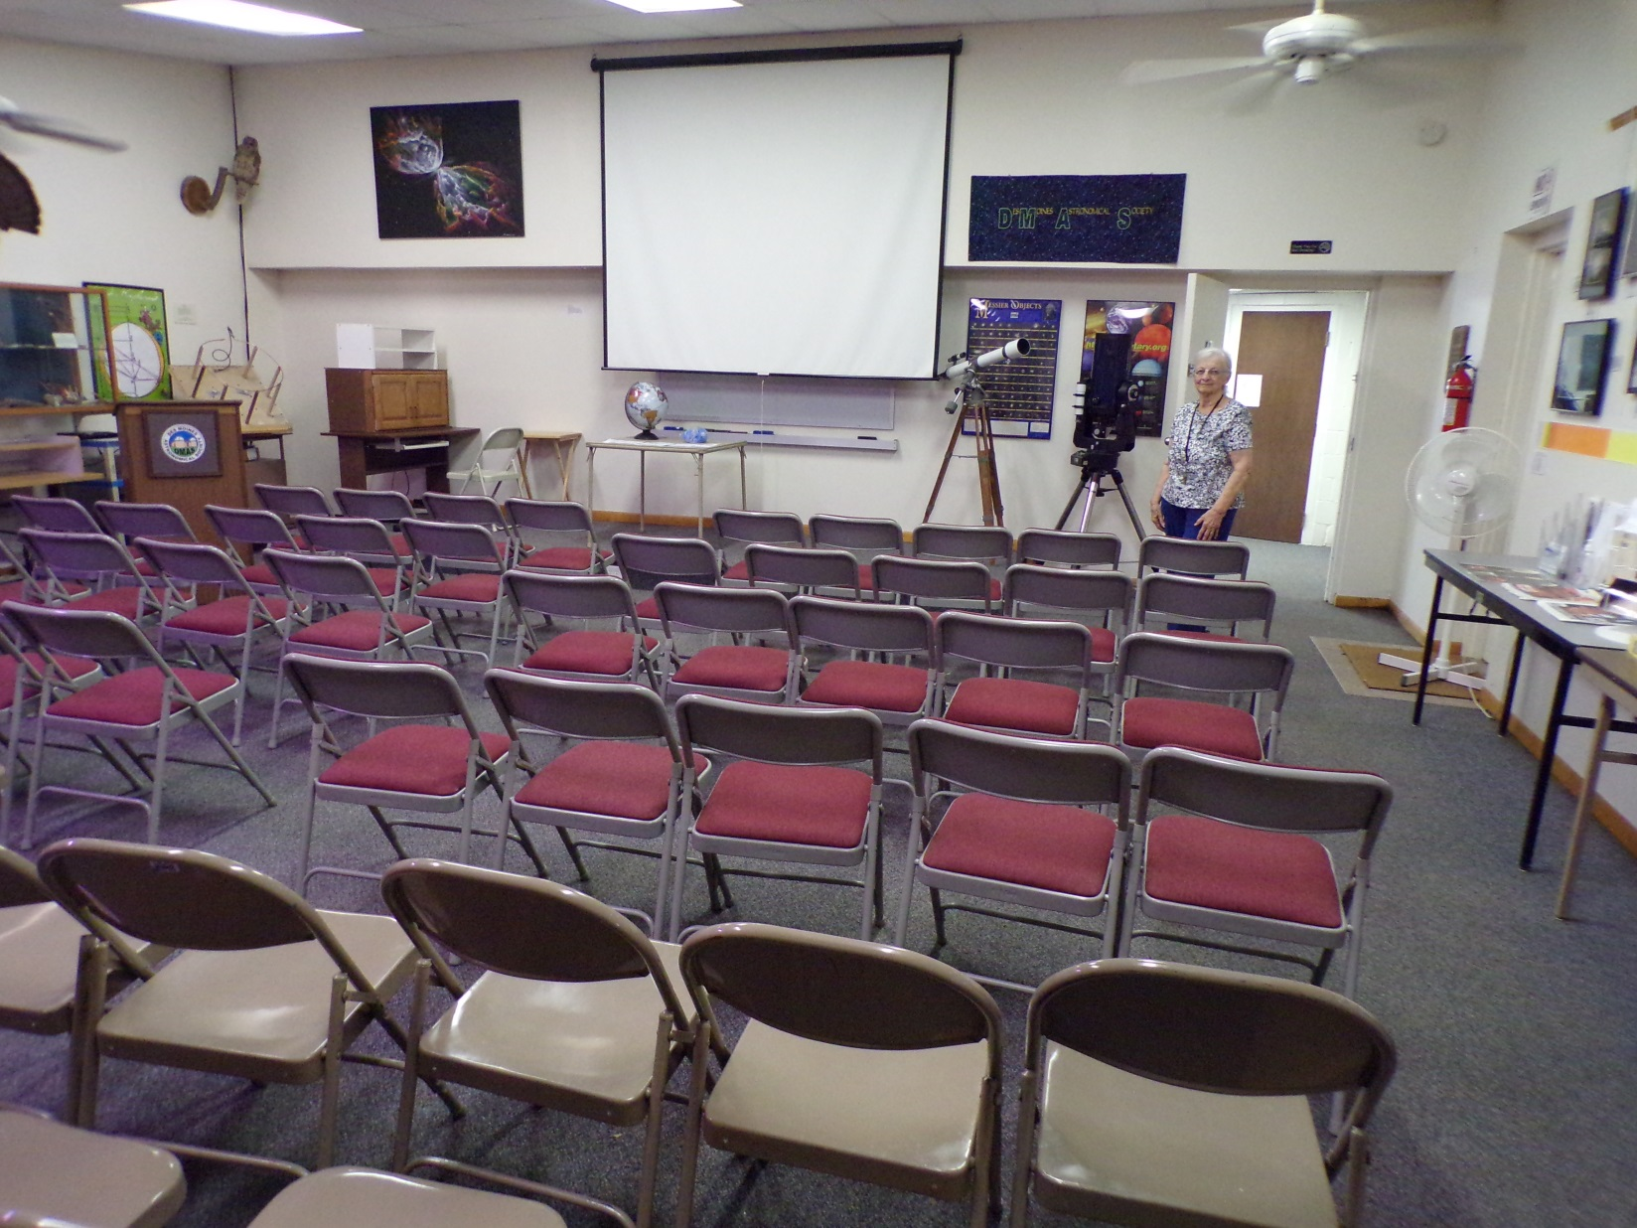
Ashton Observatory Classroom with Joyce

Slide 26
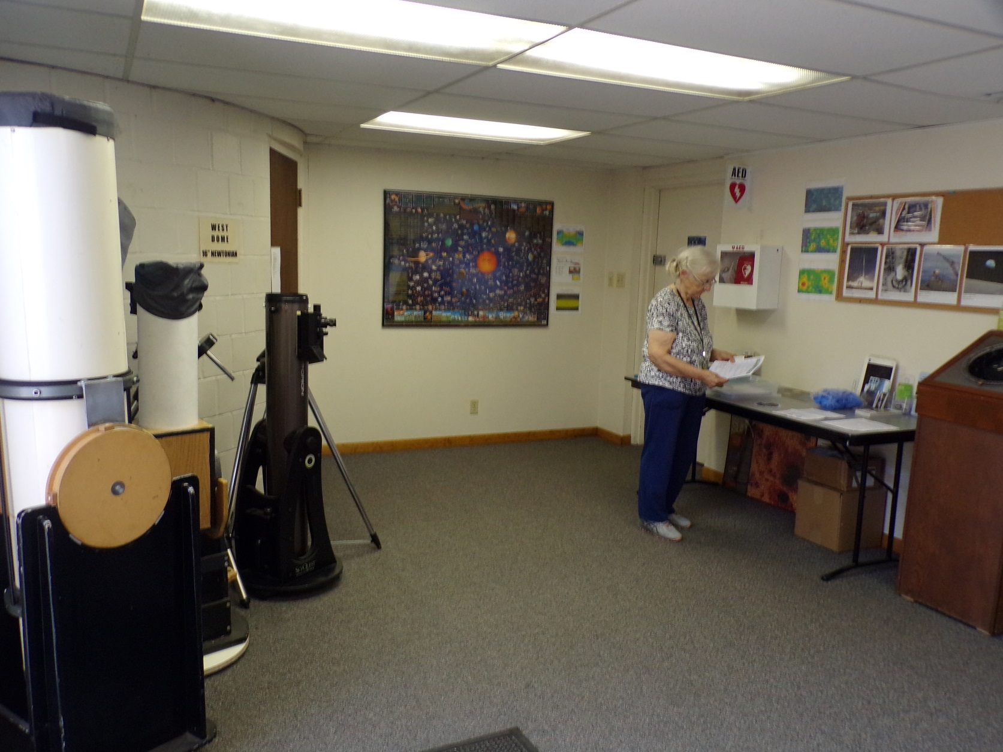
Entrance Room to the Observatory

Slide 27
II. The 32 Inch Dish Radio Telescope

Slide 28
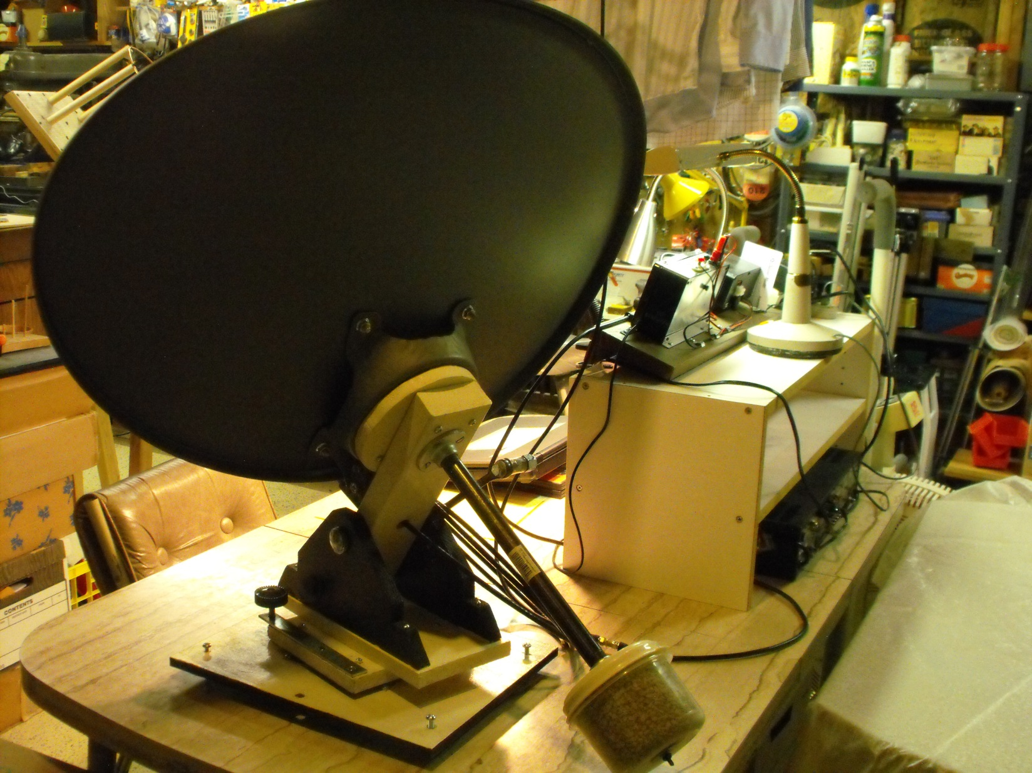
The Dish on Vern’s work bench

Slide 29
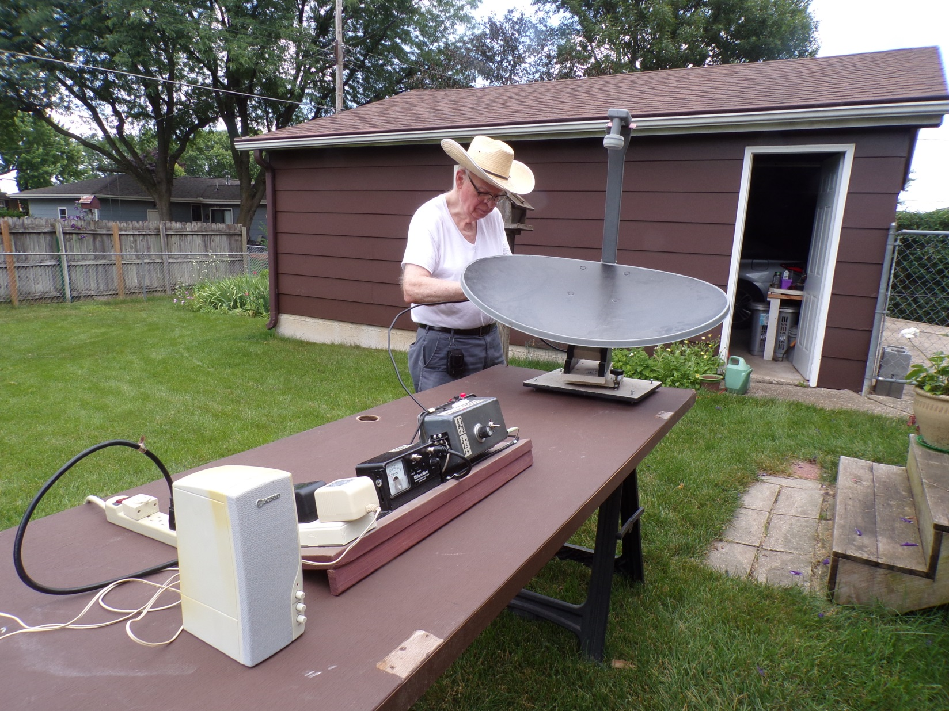
The 32 Incher laid out in the back yard

Slide 30
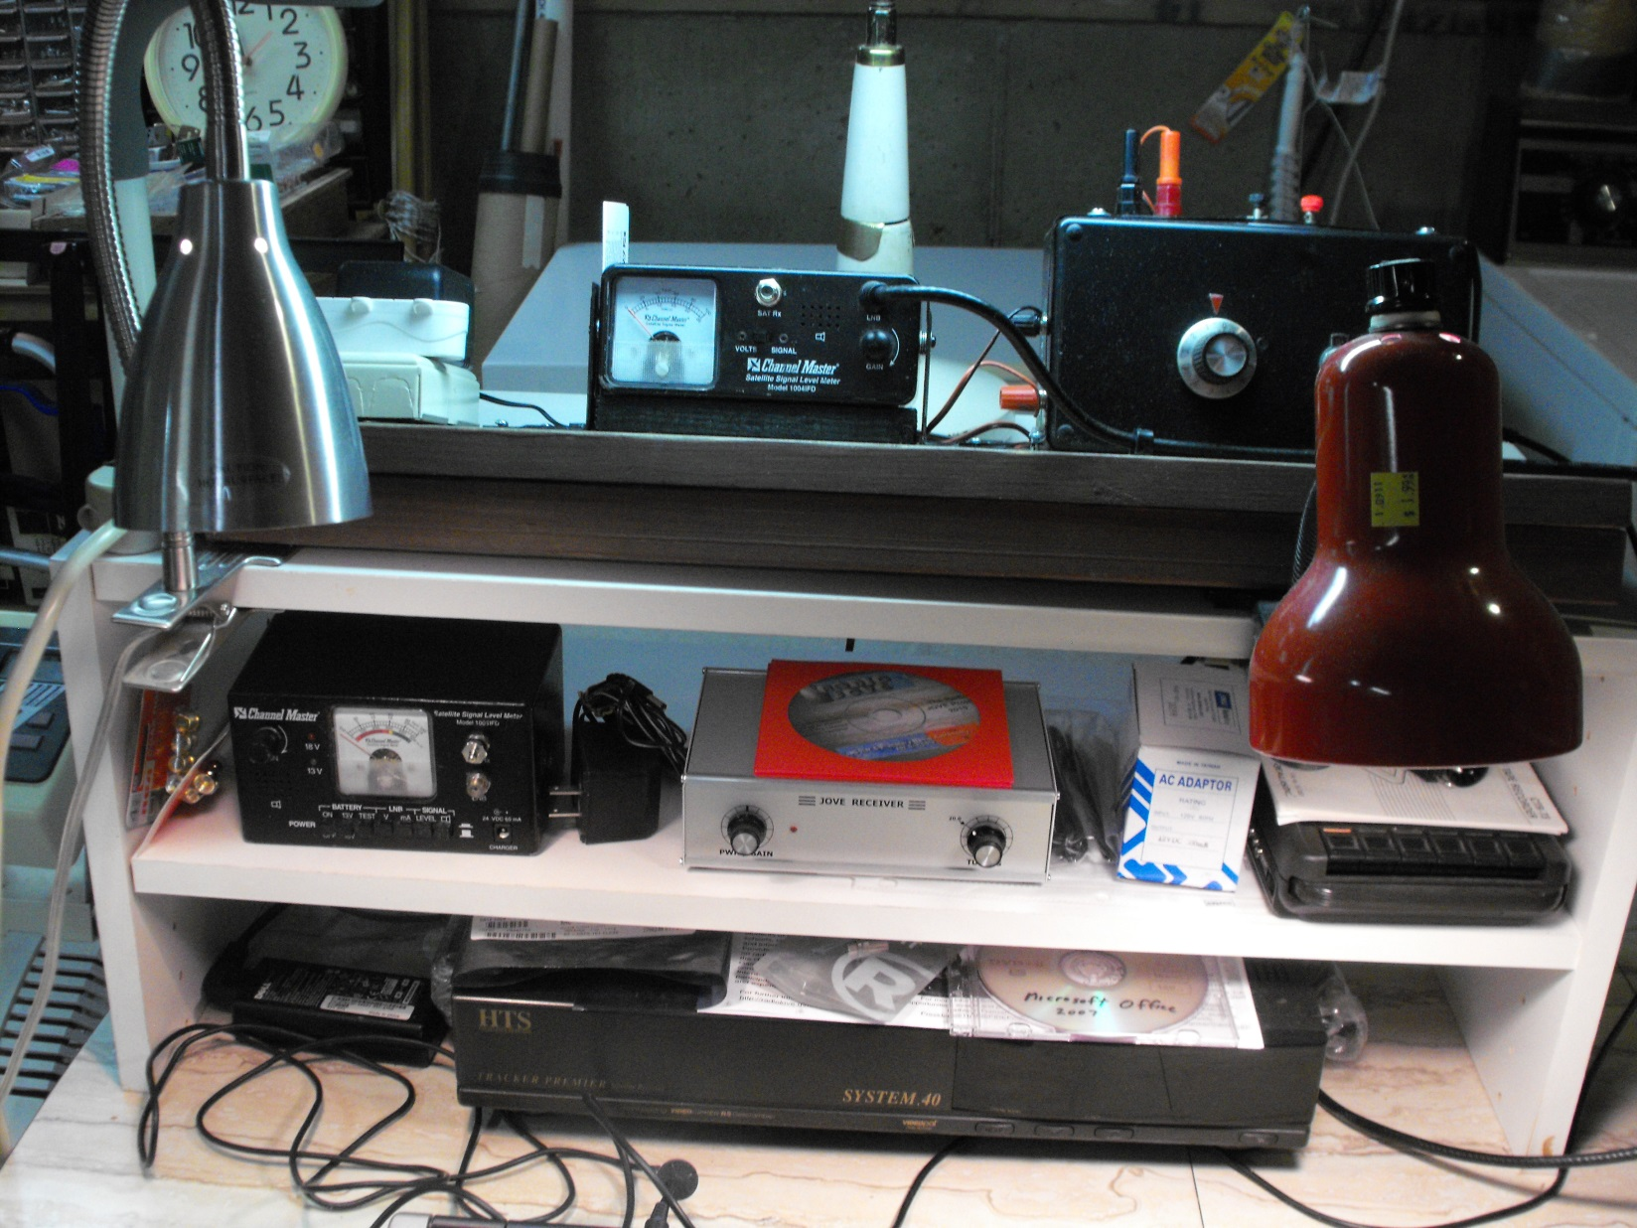
Line-up of Components and Interface
↙

Slide 31
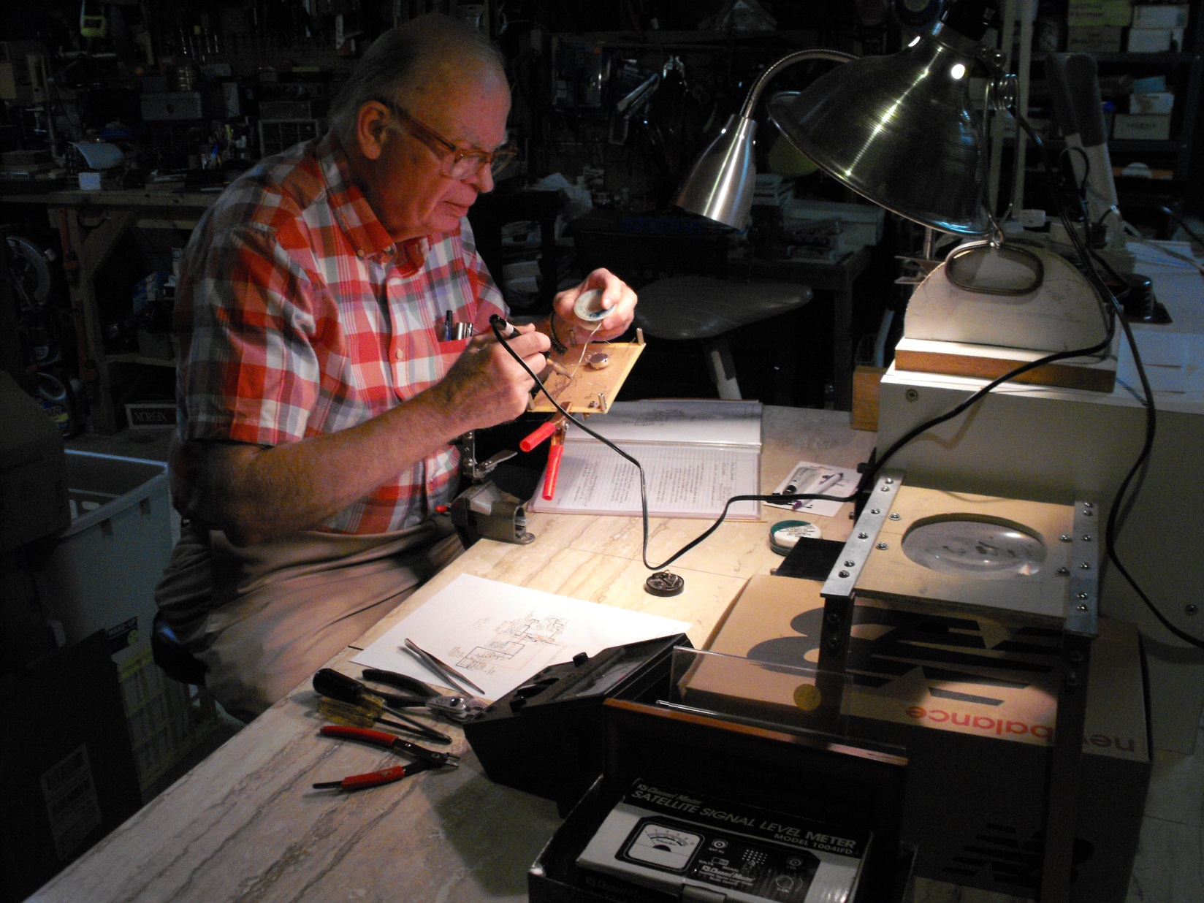
Soldering the Interface Circuit Board

Slide 32
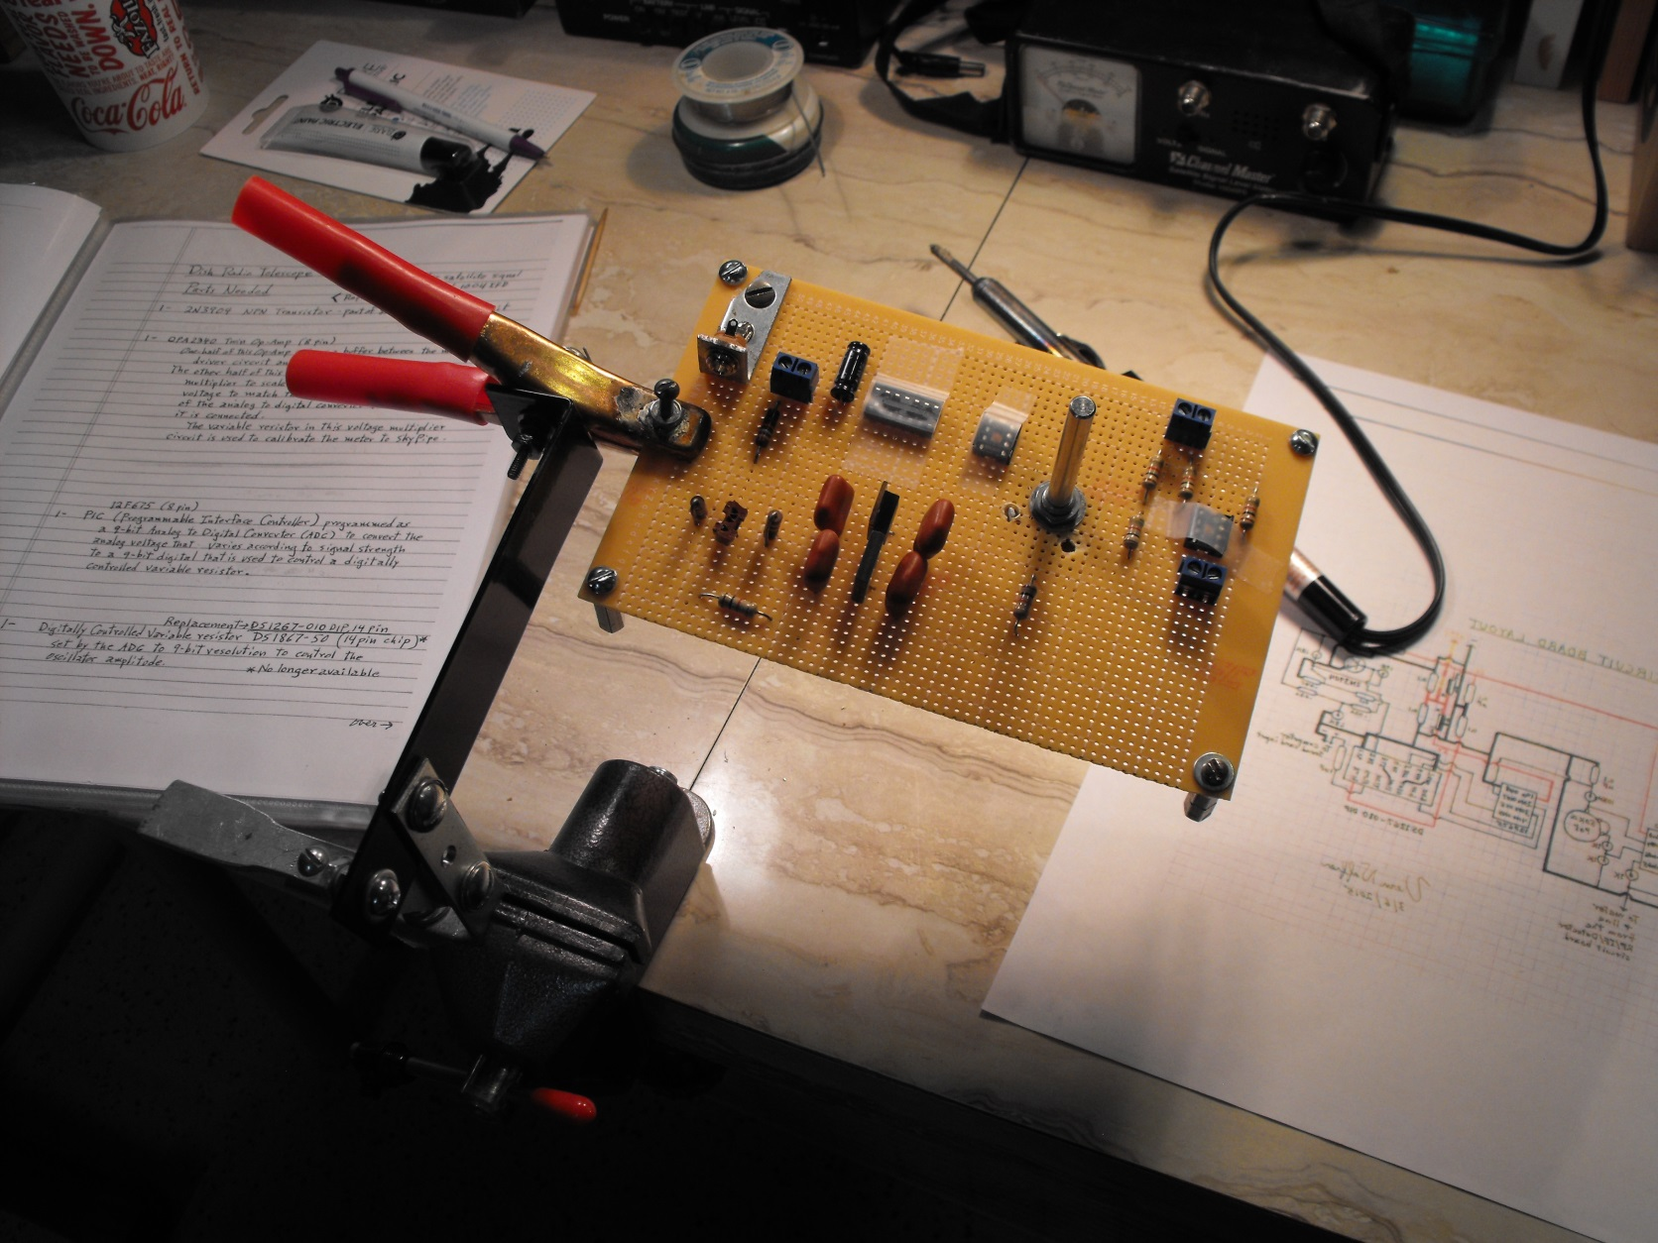
Close-Up of the Circuit Board

Slide 33
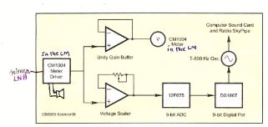
Block Diagram of the Interface Circuit

Slide 34
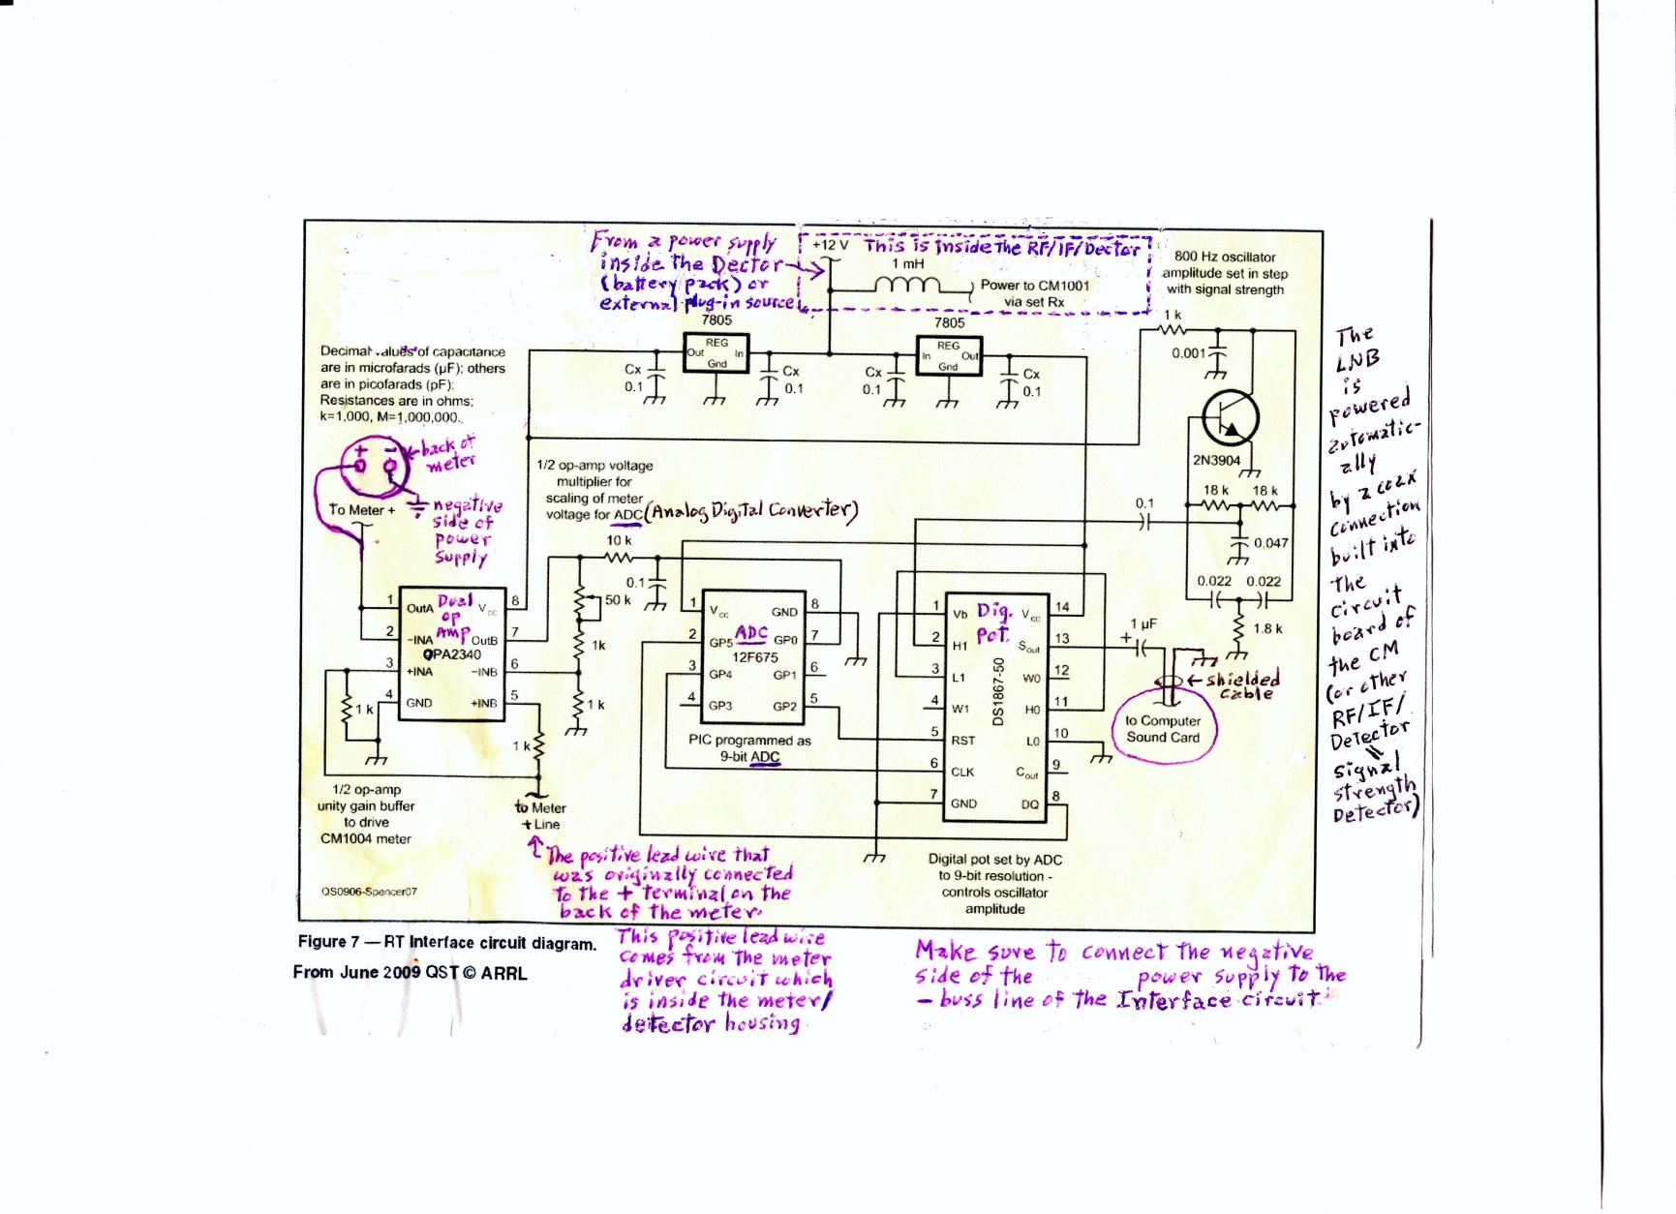
Interface Schematic

Slide 35
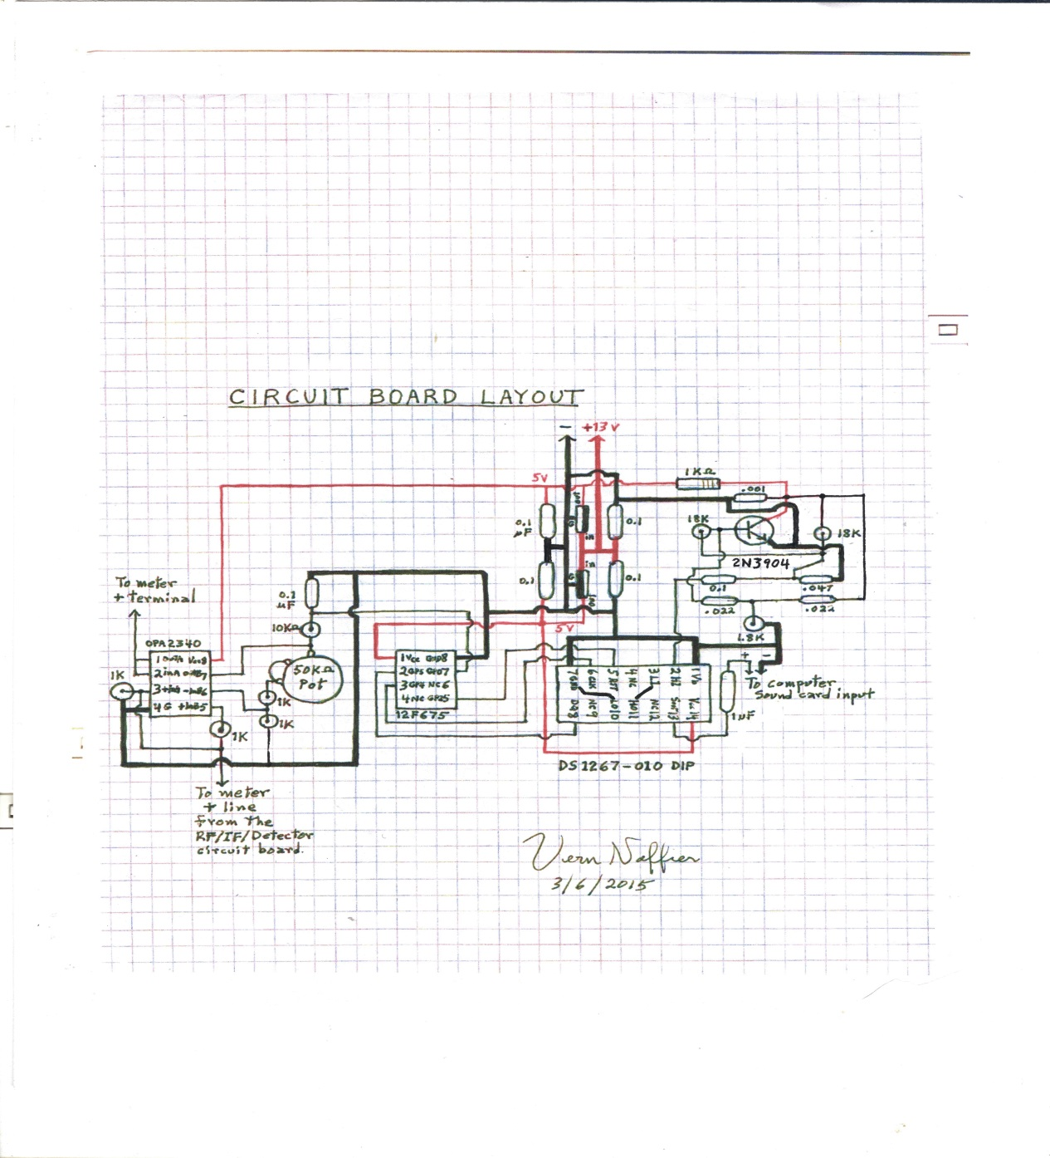
Wiring Diagram of the Circuit Board

Slide 36
III. The JOVE Radio Telescope

Slide 37
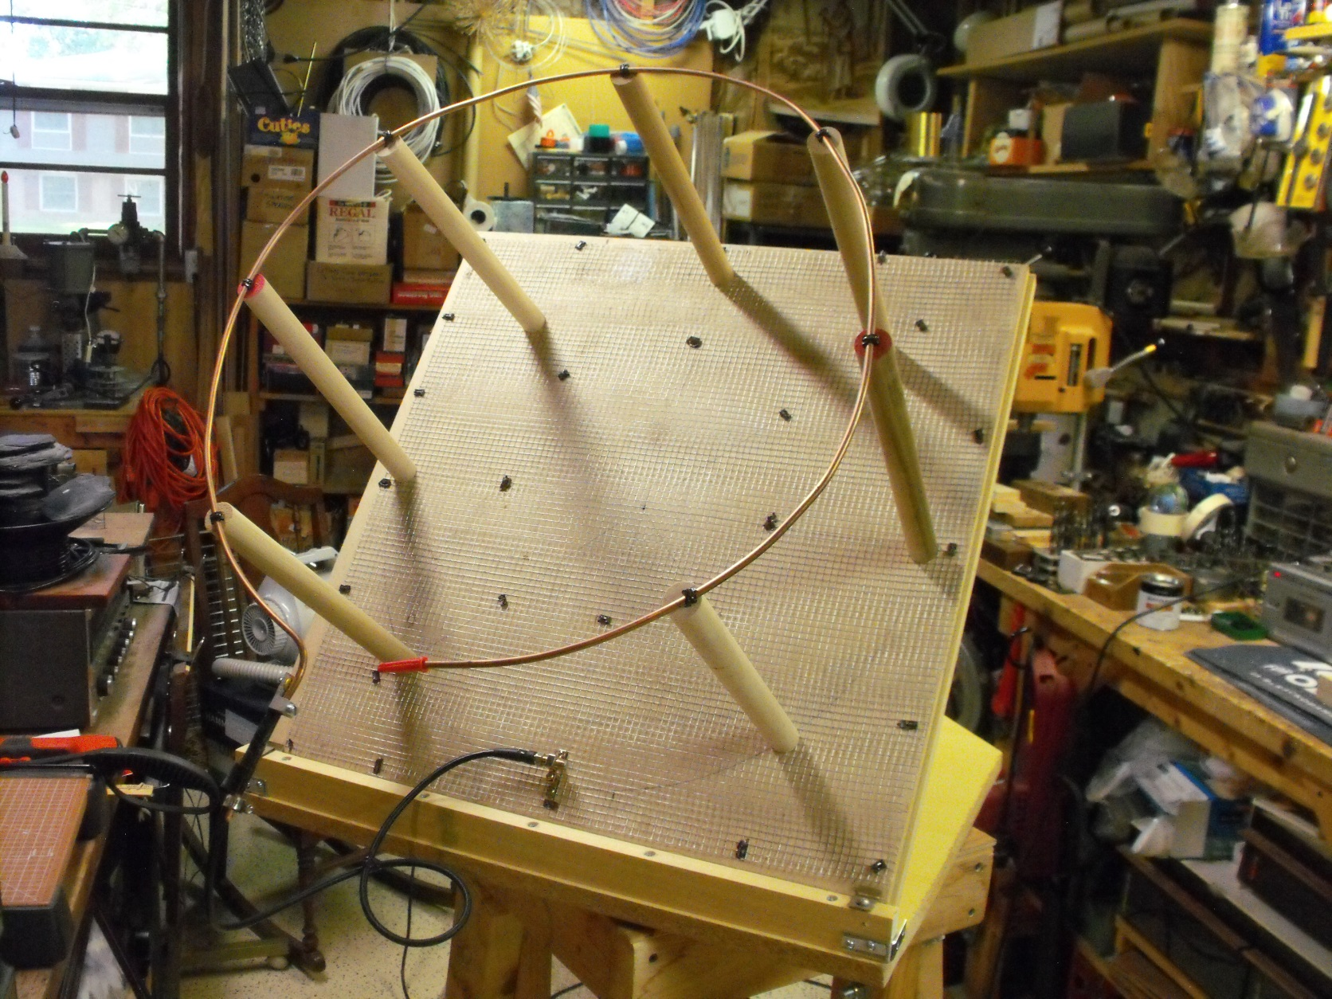
The JOVE 22 MHz Loop Antenna

Slide 38
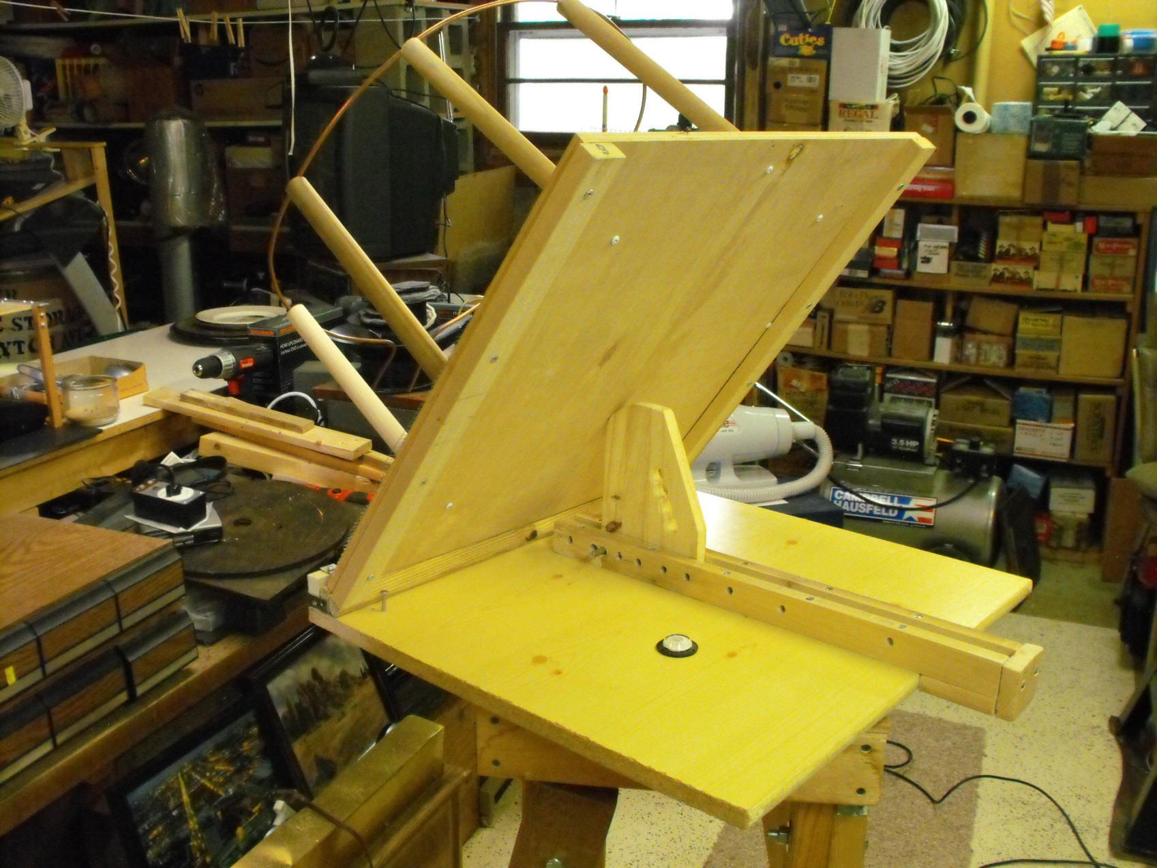
The JOVE Antenna Mount

Slide 39
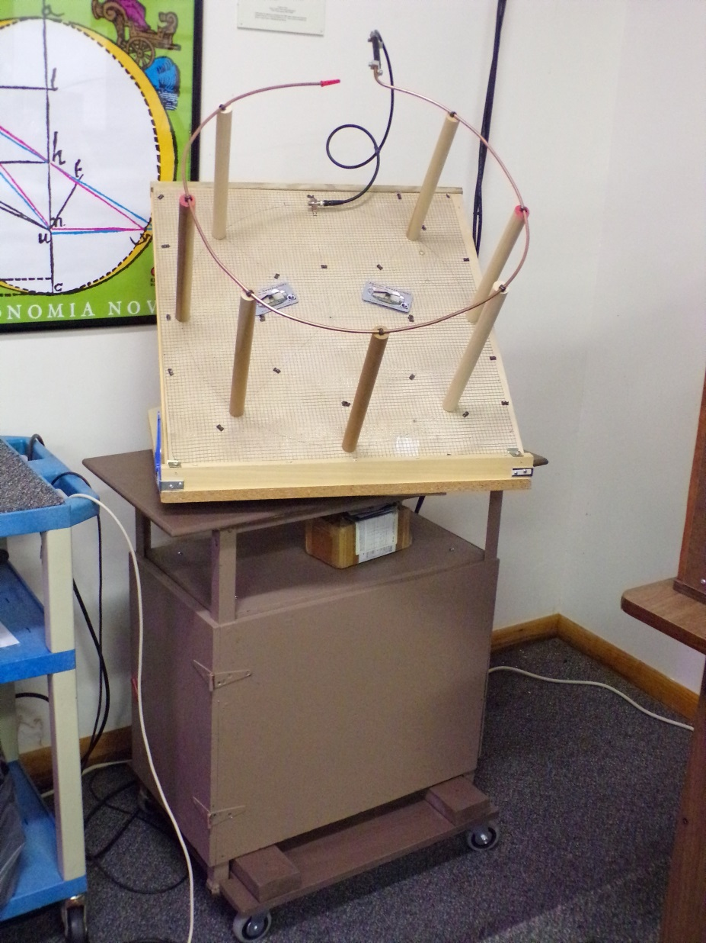
Roll-out cart to support small antennas

Slide 40

The JOVE Receiver
↙

Slide 41
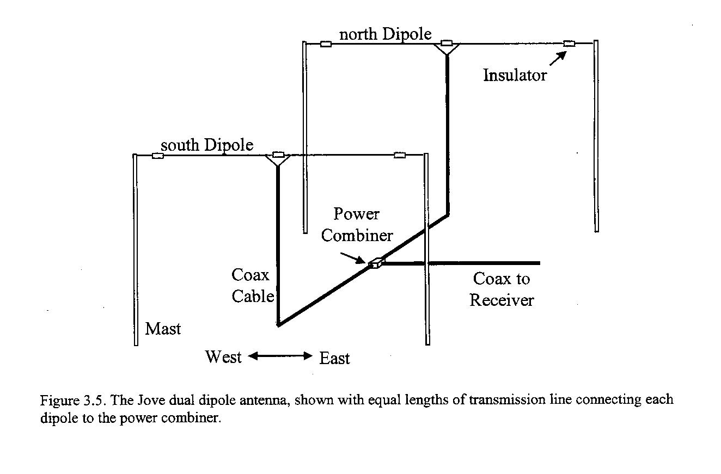
Alternative JOVE Long-Wire Antenna

Slide 42
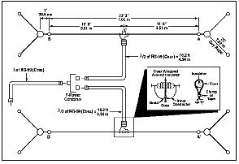
Long-Wire Antenna Dimensions (View from above)

Slide 43
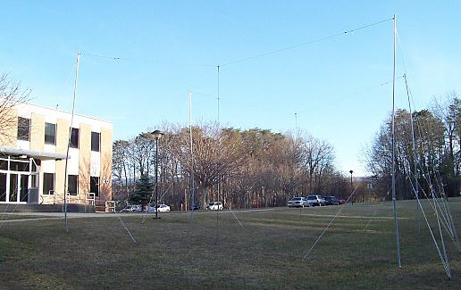
Set-Up of Long-Wire Double-Dipole Antenna

Slide 44
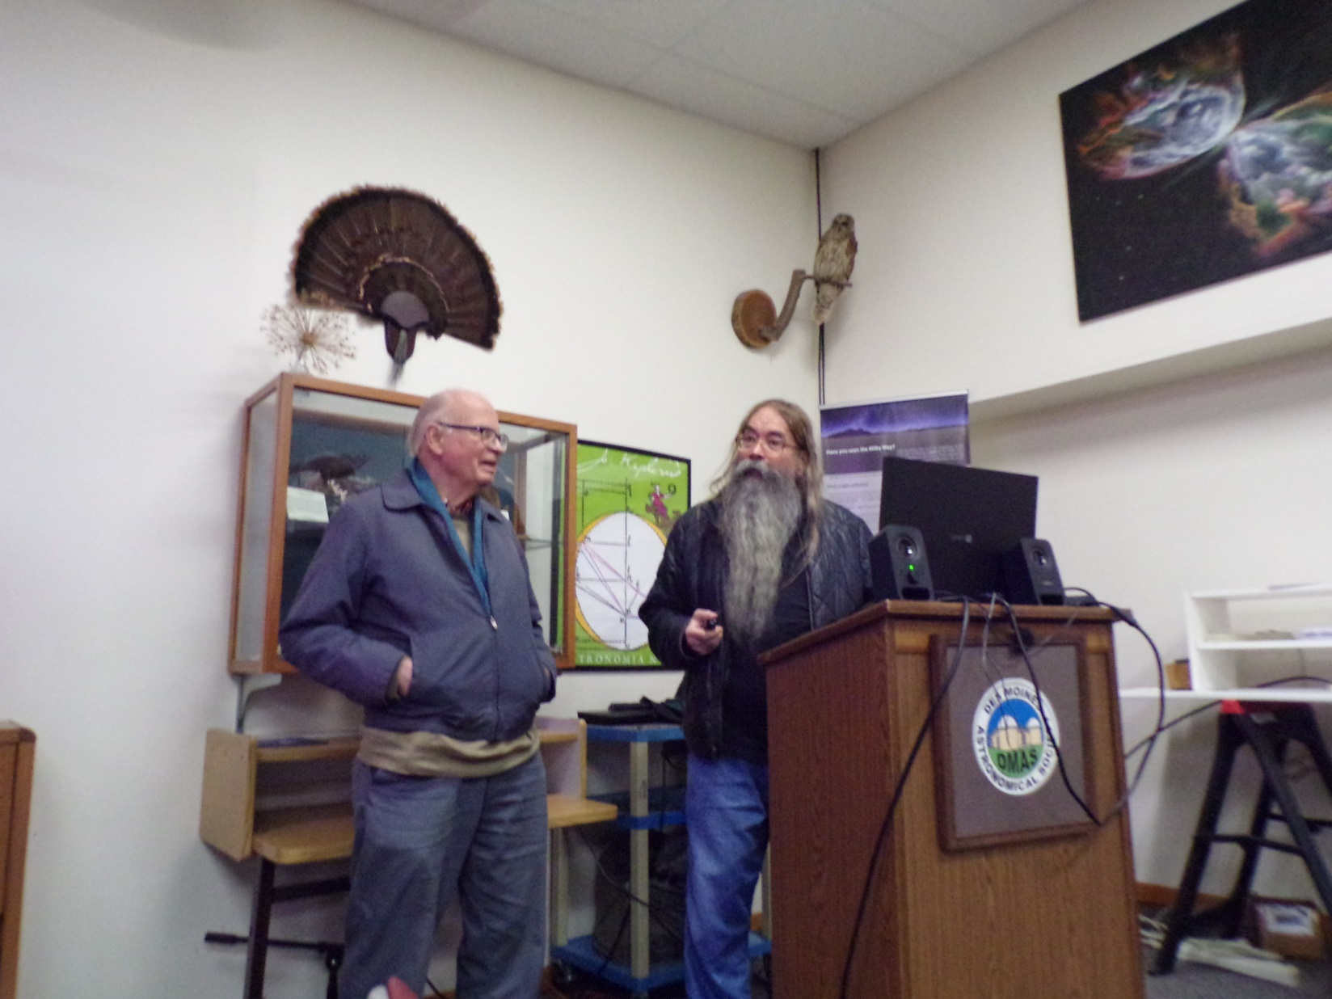
Ken Young and Vern Naffier Collaborating

Slide 45
Still more work to be done.

